Slide 1
Icon guide
Students should complete this task on their own.
Students should complete this task in pairs. Pair talk would work well with this activity.
This task may be completed in small groups.
This task should be modelled by the teacher. A model is provided, but teachers may want to complete an addition class model ’live’ with the group.
The answers to this task should be written. Teachers may decide that some tasks without this icon should also be written down – this is down to a teacher’s discretion.
This icon is a reminder that students will sit a fortnightly mastery quiz at the end of this lesson.

Slide 2
In this lesson, students will be mastering the following:
Mastery Content:
Jane considers going to school
Juxtaposition is a literary technique where a writer places very different things or people close to each other
Characters are juxtaposed in ‘Jane Eyre’ to create sympathy for Jane
Learning Objective:
To explore how juxtaposition creates sympathy for Jane.
Mastery Content

Slide 3
Do Now Which characters treat Jane kindly? Which characters are cruel and malicious to Jane? Why does Mr Lloyd visit Jane? Jane is strong, defiant and rebellious. Why is this the opposite of Victorian expectations of children? Extension: Why does Mr Lloyd suggest that Jane should go to school?
Juxtaposition Introduce the term juxtaposition and illustrate with examples from the texts we have read. Apply to 'Jane Eyre' by relating to the Do Now task.
Reading: Chapter 3 Read to the end of Chapter 3. There is a check for understanding task which asks students to identify why Jane wants to go to school.
Juxtaposition: characters Discuss the juxtaposition of Bessie and Miss Abbot – how they help to emphasise how little compassion she receives from the adults in her life.
Juxtaposition Students answer the following question: How does Brontë juxtapose Mr Lloyd and Mrs Reed to create sympathy for Jane in the opening chapters of ‘Jane Eyre’? The previous two discussion activities should have helped prepare students to answer this question. | There is a model paragraph, but you may also want to co-write a sentence starter for their own independent writing.
Mastery assessment plenary Students complete quiz.
Lesson Guide

Slide 4
Tuesday, 14 June 2022
Juxtaposition
Do Now:
Bessie and Mr Lloyd treat Jane kindly?
Mrs Reed, John Reed and Miss Abbot are cruel and malicious to Jane.
Mr Lloyd is an apothecary who checks on Jane after she faints in the Red Room.
Victorians expected children to be obedient, meek and subservient.
Do Now:
Which characters treat Jane kindly?
Which characters are cruel and malicious to Jane?
Why does Mr Lloyd visit Jane?
Jane is strong, defiant and rebellious. Why is this the opposite of Victorian expectations of children?
Do Now
Extension: Mr Lloyd’s suggestion of sending Jane to school is his best attempt at intervening in the cruel way Mrs Reed treats Jane.
Extension: Why does Mr Lloyd suggest that Jane should go to school?

Slide 5
Charlotte Brontë uses many techniques as a writer to communicate her point of view.
One technique she uses is called juxtaposition.
Juxtaposition is a literary technique where a writer places very different things or people close to each other. This helps to show how the things are similar or different.
Let’s look at some examples.
Juxtaposition

Slide 6
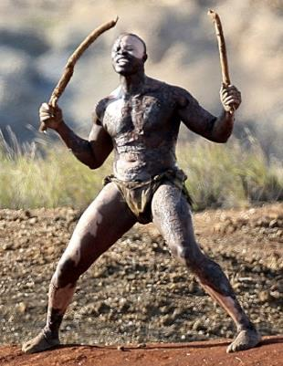
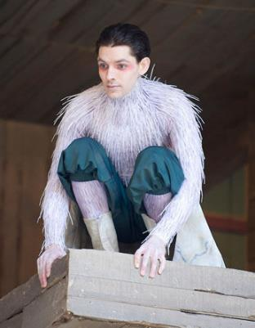
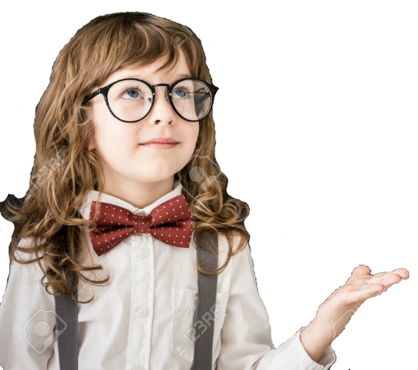
In ‘The Tempest’, there was a juxtaposition between Caliban and Ariel.
Both of the characters were Prospero’s servants.
Both were strange, otherworldly creatures.
Juxtaposition
Caliban
Ariel
The juxtaposition of Caliban and Ariel helps to emphasise how violent and grotesque Caliban is, and how cruelly Prospero treats him.

Slide 7
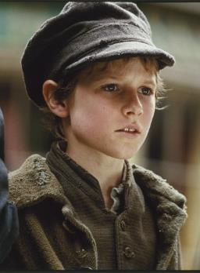
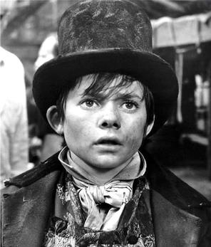
In ‘Oliver Twist’, there was a juxtaposition between Oliver and Dodger.
Both of the characters were orphans.
They both lived in London with Fagin.
Juxtaposition
Oliver
Dodger
The juxtaposition of Oliver and Dodger draws attention to how naïve and innocent Oliver is. The comparison between the characters shows how good Oliver is. He always wants to do the right thing and refuses to steal, unlike Dodger.

Slide 8
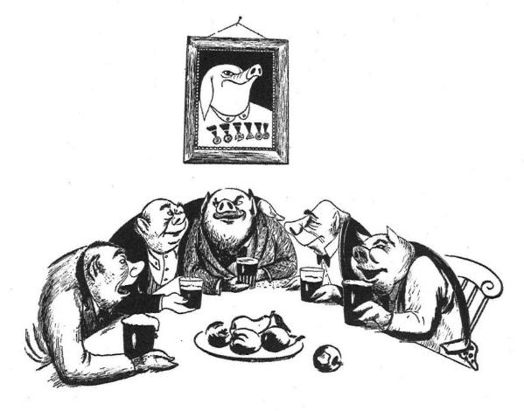
At the end of ‘Animal Farm’, there was a juxtaposition between Napoleon and the pigs and the humans.
‘No question, now, what had happened to the faces of the pigs. The creatures outside looked from pig to man, and from man to pig, and from pig to man again; but already it was impossible to say which was which.’
Juxtaposition
The juxtaposition of the pigs and the humans confirms how corrupt the pigs have finally become. Next to the neighbouring farmers, the pigs look exactly the same. Napoleon and the other pigs have become the disgusting tyrants they were meant to overthrow.

Slide 9
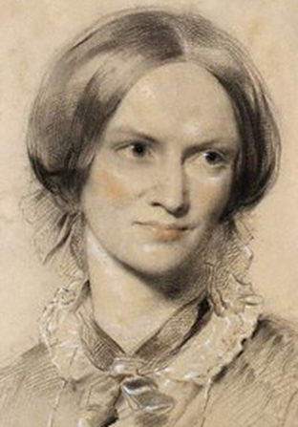
Juxtaposition is a literary technique where a writer places very different things or people close to each other. This helps to show how the things are similar or different.
Charlotte Brontë uses juxtaposition throughout ‘Jane Eyre’. For example, Brontë juxtaposes good and kind characters, such as Mr Lloyd, with cruel characters, like Mrs Reed.
Juxtaposition
This technique makes the reader pick sides! We usually side with Jane and the characters that are nice to her.
Charlotte Brontë

Slide 10
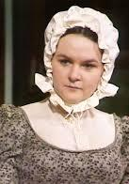
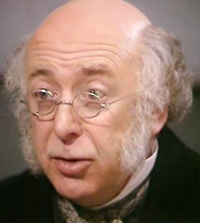
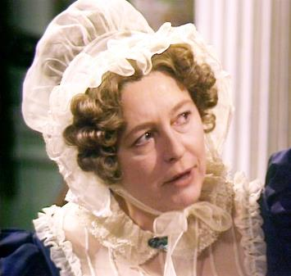
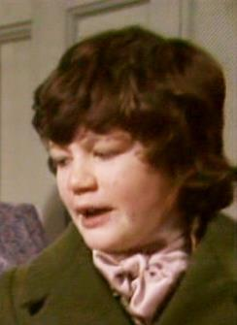
Good and kind characters
Cruel and malicious characters
Bessie
Mr Lloyd
Mrs Reed
John
Juxtaposition
Juxtaposition encourages the reader to reflect on their own opinion. If we read between the lines, we can sometimes work out the author’s viewpoint as well.
In pairs, come up with a list of answers to this question:
Why does Charlotte Brontë juxtapose these sets of characters?
Charlotte Brontë

Slide 11
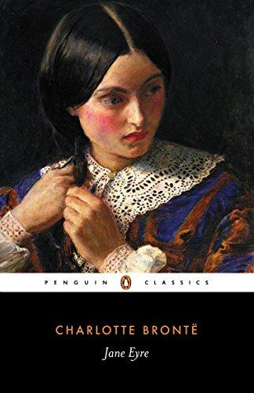
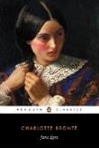
We will look at juxtaposition as we read.
Let’s continue reading.
Read from Chapter 3, ‘Would you like to go to school?’ (page 30)
Read to the end of Chapter 3.
Jane Eyre
p.30

Slide 12
Again I reflected: I scarcely knew what school was: Bessie sometimes spoke of it as a place where young ladies sat in the stocks, wore backboards, and were expected to be exceedingly genteel and precise: John Reed hated his school, and abused his master; but John Reed’s tastes were no rule for mine, and if Bessie’s accounts of school-discipline (gathered from the young ladies of a family where she had lived before coming to Gateshead) were somewhat appalling, her details of certain accomplishments attained by these same young ladies were, I thought, equally attractive. She boasted of beautiful paintings of landscapes and flowers by them executed; of songs they could sing and pieces they could play, of purses they could net, of French books they could translate; till my spirit was moved to emulation as I listened. Besides, school would be a complete change: it implied a long journey, an entire separation from Gateshead, an entrance into a new life.
stocks – wooden locks for hands
exceedingly genteel – very polite
accomplishments – achievements
attained – achieved
executed – made
emulation – imitate or copy
Jane Eyre
p.30

Slide 13
“I should indeed like to go to school,” was the audible conclusion of my musings.
“Well, well! who knows what may happen?” said Mr. Lloyd, as he got up. “The child ought to have change of air and scene,” he added, speaking to himself; “nerves not in a good state.”
Bessie now returned; at the same moment the carriage was heard rolling up the gravel-walk.
“Is that your mistress, nurse?” asked Mr. Lloyd. “I should like to speak to her before I go.”
Bessie invited him to walk into the breakfast-room, and led the way out. In the interview which followed between him and Mrs. Reed, I presume, from after-occurrences, that the apothecary ventured to recommend my being sent to school; and the recommendation was no doubt readily enough adopted; for as Abbot said, in discussing the subject with Bessie when both sat sewing in the nursery one night, after I was in bed, and, as they thought, asleep, “Missis was, she dared say, glad enough to get rid of such a tiresome, ill-conditioned child, who always looked as if she were watching everybody, and scheming plots underhand.” Abbot, I think, gave me credit for being a sort of infantine Guy Fawkes.
musings – thoughts
adopted – accepted
tiresome – annoying
ill-conditioned – rude
infantine – young
Jane Eyre
p.30-31

Slide 14
On that same occasion I learned, for the first time, from Miss Abbot’s communications to Bessie, that my father had been a poor clergyman; that my mother had married him against the wishes of her friends, who considered the match beneath her; that my grandfather Reed was so irritated at her disobedience, he cut her off without a shilling; that after my mother and father had been married a year, the latter caught the typhus fever while visiting among the poor of a large manufacturing town where his curacy was situated, and where that disease was then prevalent: that my mother took the infection from him, and both died within a month of each other.
Bessie, when she heard this narrative, sighed and said, “Poor Miss Jane is to be pitied, too, Abbot.”
“Yes,” responded Abbot; “if she were a nice, pretty child, one might compassionate her forlornness; but one really cannot care for such a little toad as that.”
“Not a great deal, to be sure,” agreed Bessie: “at any rate, a beauty like Miss Georgiana would be more moving in the same condition.”
clergyman – vicar
typhus – an infectious disease
prevalent – common
narrative – story
forlornness – sadness
Jane Eyre
p.30-31

Slide 15
“Yes, I doat on Miss Georgiana!” cried the fervent Abbot. “Little darling!—with her long curls and her blue eyes, and such a sweet colour as she has; just as if she were painted!—Bessie, I could fancy a Welsh rabbit for supper.”
“So could I—with a roast onion. Come, we’ll go down.” They went.
doat – feel affection for
fervent – enthusiastic
Jane Eyre
p.30-31

Slide 16
Jane overhears Bessie and Miss Abbot talking and learns that she might be sent away to school. Jane lists a number of reasons why she would like to go to school.
Which of these are the reasons Jane wants to go to school?
At school, Jane will be able to misbehave as much as she likes without being put in the red-room.
She looks forward to learning how to draw and play the piano.
She wants to start a new life away from Gateshead.
Jane wants to get away from Georgiana because she is jealous of her beautiful hair.
She would like to learn to speak French.
Jane Eyre
At school, Jane will be able to misbehave as much as she likes without being put in the red-room.
She looks forward to learning how to draw and play the piano.
She wants to start a new life away from Gateshead.
Jane wants to get away from Georgiana because she is jealous of her beautiful hair.
She would like to learn to speak French.

Slide 17
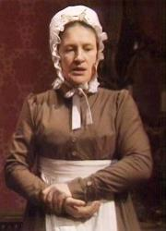
Juxtaposition is a literary technique where a writer places very different things or people close to each other. This helps to show how the things are similar or different.
One example of juxtaposition in the passage we have just read is between the views of Bessie and Miss Abbot.
“Poor Miss Jane is to be pitied, too, Abbot.”
Jane Eyre
“Yes, if she were a nice, pretty child, one might compassionate her forlornness; but one really cannot care for such a little toad as that.”
Bessie
Miss Abbot
Why does Charlotte Brontë juxtapose these two characters?

Slide 18
You are going to write an answer to this question:
How does Brontë juxtapose Mr Lloyd and Mrs Reed to create sympathy for Jane in the opening chapters of ‘Jane Eyre’?
Jane Eyre
Mr Lloyd
Mrs Reed

Slide 19
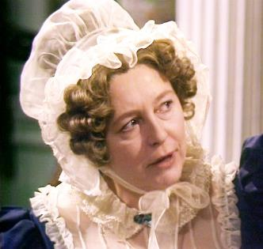
Charlotte Brontë juxtaposes the characters of Mrs Reed and Mr Lloyd in the opening chapters of ‘Jane Eyre’ to highlight how miserable Jane’s life at Gateshead Hall is. The only kindness Jane receives is from a stranger, and someone from outside of her home. Compare this to Mrs Reed, who actively despises and mistreats her niece. Mrs Reed is Jane’s only family, and a reader would expect her to treat Jane well. However, the only time someone talks to Jane with respect and care is when a visitor from outside comes to the house. Mr Lloyd offers Jane a momentary
Jane Eyre
respite from her otherwise wretched life. He helps to show a reader that Jane will have moments of happiness, despite her awful family.
Mr Lloyd
Mrs Reed

Slide 20
Which of the following are examples of juxtaposition in ‘Jane Eyre’?
a) Bessie is juxtaposed with Miss Abbot to show how even the servants can treat Jane badly.
b) John Reed is juxtaposed with Mrs Reed to show how violent John Reed is.
c) Jane is juxtaposed with John Reed to show how John Reed gets favourable treatment from Mrs Reed.
d) Jane passing out in the red-room is juxtaposed with her waking up in bed to show how awful it was for her to be locked in the room.
e) Mr Lloyd is juxtaposed with Bessie to show how badly the adults at Gateshead Hall treat Jane.
Mastery

Slide 21
Which of the following are examples of juxtaposition in ‘Jane Eyre’?
a) Bessie is juxtaposed with Miss Abbot to show how even the servants can treat Jane badly.
b) John Reed is juxtaposed with Mrs Reed to show how violent John Reed is.
c) Jane is juxtaposed with John Reed to show how John Reed gets favourable treatment from Mrs Reed.
d) Jane passing out in the red-room is juxtaposed with her waking up in bed to show how awful it was for her to be locked in the room.
e) Mr Lloyd is juxtaposed with Bessie to show how badly the adults at Gateshead Hall treat Jane.
Review

Slide 22
Love this lesson?
Have suggestions for improvements?
Does something need fixing?
Feedback
Please let us know!
Fill in this feedback form so that we can keep improving.

