Slide 1
AIC Revision and Essay Plan
11.10.18

Slide 2
Important information: Literature Paper 2 (‘Modern Drama and Literary Heritage Texts’ aka A:AIC/B:Macbeth) Open Book (you will get a blank copy in the exam) 30marks/45mins on each question Answer 1 on each from a choice of 2 (theme/character)

Slide 3
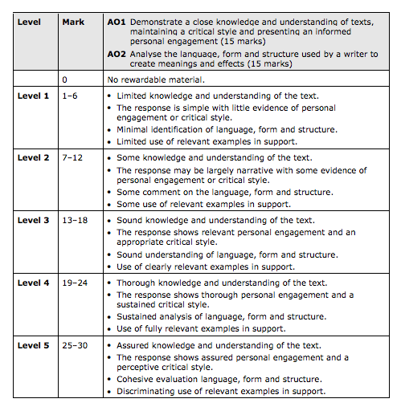
LIT PAPER 2, MODERN DRAMA AND LITERARY HERITAGE:
SECTION A MODERN DRAMA (AN INSPECTOR CALLS)
AO1 – How well you know AIC
A02 – Language, form and structure

Slide 4
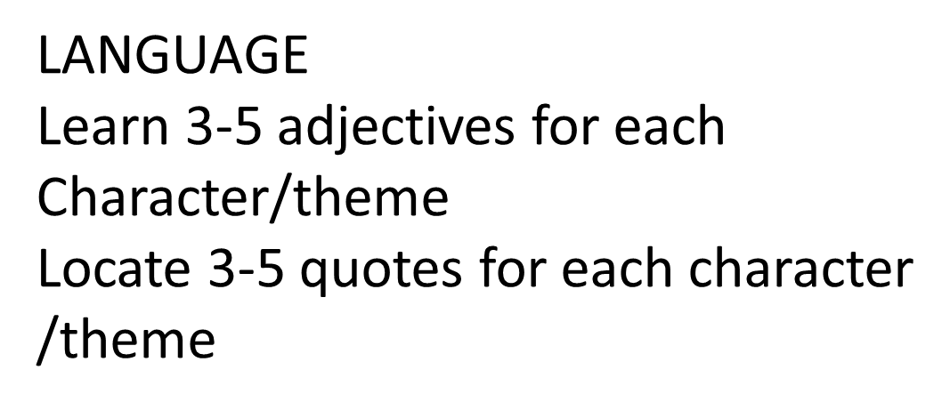
Language used by
Different characters:
MR B – Colloquial, pompous, egotistical, working class
MRS B – pretentious, upper class,
Etc.
FORM/STRUCTURE
Takes place in 1 room over 1 day
= INTENSE, REALISTIC AND DRAMATIC
Stage directions – v specific, lots
Of pauses, adverbs (gently, warmly)- Priestley had clear opinions
-DRAMATIC IRONY ‘fiddlesticks’, ‘unsinkable’

Slide 5
June 2018 Exam Qs:

Slide 6
Exemplar Qs:
Inspector: ‘There’ll be plenty of time, when I am gone, for you all to adjust your family relationships.’
Explore the significance of family relationships in An Inspector Calls.
Explore Priestley’s presentation of Gerald in the play.
How does Priestley present the theme of injustice in this play?
You must consider language, form and structure in your answer.
Sybil Birling: ‘You have no power to make me change my mind.’
Explore Priestley’s presentation of Mrs Sybil Birling in the play.

Slide 7
PAST Qs
Explore the changing relationship between Gerald Croft and Sheila Birling in An Inspector Calls.
‘Public men, Mr Birling, have responsibilities as well as privileges.’ (Inspector Goole)
How does Priestley present the importance of responsibility in this play?
How does Priestley present the character of Eva Smith/Daisy Renton?
‘The play is more concerned with moral responsibilities than the law itself.’ How far do you agree with this statement?
How does Priestley present Mrs Birling’s relationships with other characters in this play?
‘After Inspector Goole has left, the play becomes even more dramatic.’
How far do you agree with this view of the ending of this play?
How does Priestley present the Inspector as the opposite of Mr Birling?
‘She came to you for help at a time when no woman could have needed it more.’ (Inspector Goole)
Explore the role of women in this play.
Explore how Priestley presents the younger generation in AIC.

Slide 8
Predictions:? Not just Shiela or Goole But could be anyone else!

Slide 9
Structuring your essay…
INTRO
Answer the question using sophisticated vocab to describe characters. Always use the phrase ‘Priestley uses…’ and, if you
Can ‘…the audience’. Always try to deal with the play from a synoptic pov. Briefly refer to how character/theme is introduced,
How it it/they change/develop during middle of the play and how they are at the end. KEEP IT BRIEF, QUOTES ARE OK BUT
ONLY TINY ONES.
I would always go chronological, it is easier, but if you write well it will still fulfil all MS AOS.
MAKE SURE YOU REFER TO HOW P DOES IT – Structure of play, 3 acts, realistic time, intense….
Embedding of Qs vital AND technical terminology.
I’d say 3-5 MAIN POINTS – REFER TO LANG, FORM, STRUCTURE
Conclusion – END WITH END AND MAKE AN EVALUATIVE STATEMENT, END ON A QUOTE IF YOU CAN!

