Slide 1
PAPER 1, SECTION A READING (NON-FICTION), ANTHOLOGY PART 1
Teacher Comment:
(To improve you need to)
NAME: DATE:
Student comment:

Slide 2
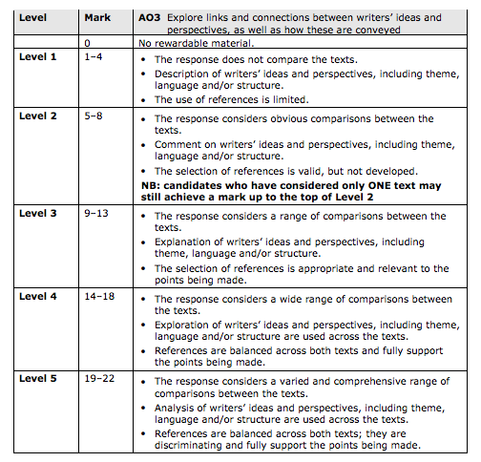
PAPER 1, SECTION A READING (NON-FICTION), COMPARISON
Teacher Comment:
(To improve you need to)
NAME: DATE:
Student comment:

Slide 3
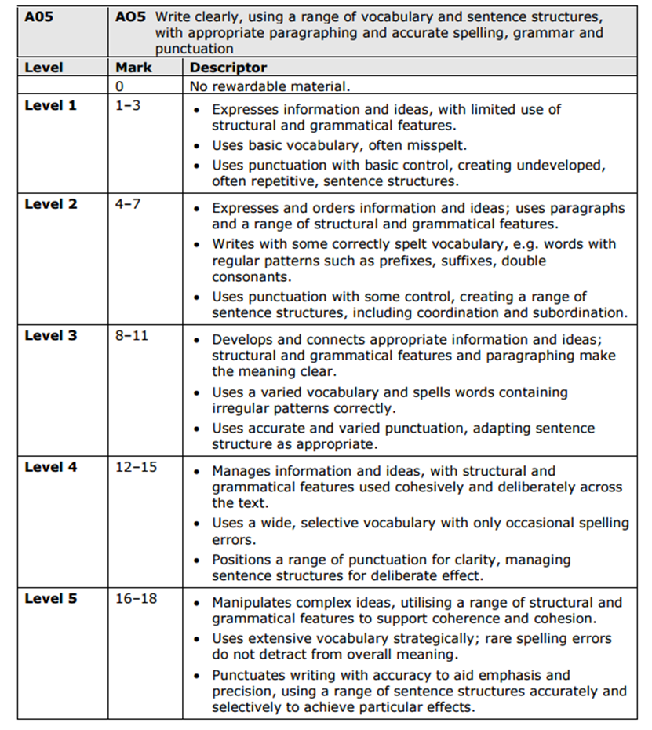
Teacher Comment:
(To improve you need to)
Student comment:
PAPER 1, SECTION B: WRITING
(TRANSACTIONAL AO4 & A05)
NAME: DATE:

Slide 4
PAPER 2 (POETRY AND PROSE) SECTION A: READING, ANTHOLOGY PART 2
Teacher Comment:
(To improve you need to)
NAME:
DATE:
Student comment:

Slide 5
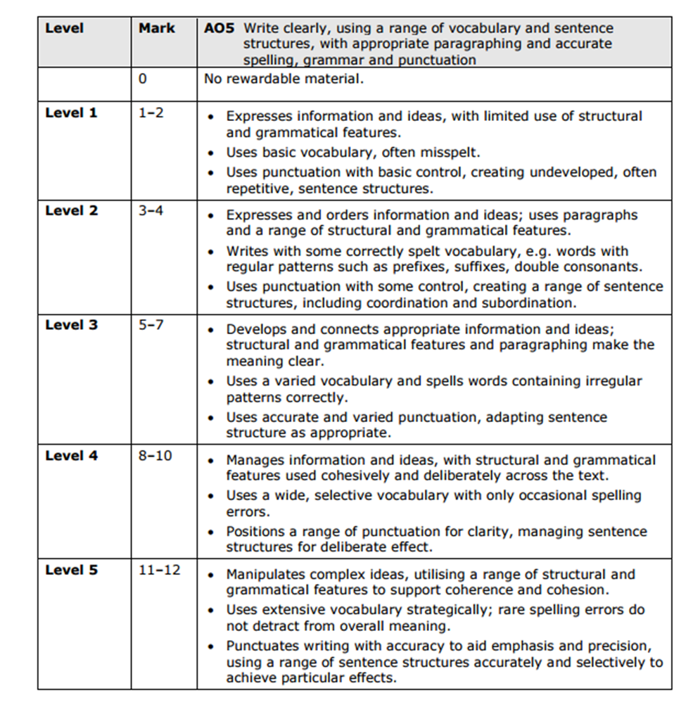
PAPER 2 (POETRY AND PROSE): SECTION B IMAGINATIVE WRITING
Teacher Comment:
(To improve you need to)
NAME: DATE:

