Slide 1
In this lesson, students will be mastering the following:
Mastery Content:
Mr Brocklehurst is an intimidating character
Mr Brocklehurst believes that children are born evil, and need to have sin driven from them with strict Christian teaching and discipline
Life at Lowood sounds harsh
Learning Objective
To learn about Mr Brocklehurst’s attitude towards children
Mastery Content

Slide 2
Do Now: What is Juxtaposition? Give an example of juxtaposition in ‘The Tempest’ Give an example of juxtaposition in ‘Oliver Twist. Give an example of juxtaposition in ‘Jane Eyre’. Extension: How were Victorians influenced by the bible in their approach to disciplining children?
Recap Recap that Mrs Reed is going to send Jane away to school. We are going to meet the headteacher in the following passage.
Reading: Mr Brocklehurst Read the passage containing Mr Brocklehurst’s introduction. There are some check for understanding questions to help assess students’ comprehension of the passage.
Victorian childhood Explain that there were three main approaches to raising children in the Victorian era. Outline these to students. They need to look at what they have found out about Mr Brocklehurst to judge which approach to raising a child he believes in.
Reading Continue reading to the moment Brocklehurst leaves.
Mr Brocklehurst Students write a response to the following question: What is Mr Brocklehurst’s attitude toward children? Think about: his Christian beliefs his approach to discipline | The question is divided into two bullet points. You may wish to complete one of the bullet points as a class model before allowing students to continue to work on the other independently.
Fortnightly Quiz Ask students to complete fortnightly quiz
Lesson Guide

Slide 3
Tuesday, 14 June 2022
Mr Brocklehurst
Do Now:
Juxtaposition is a literary technique where a writer places very different things or people close to each other.
Caliban and Ariel are juxtaposed to show how cruel Prospero is to Caliban.
Oliver and Dodger are juxtaposed to show how innocent Oliver is.
Jane is juxtaposed with John Reed to show how John Reed gets favourable treatment from Mrs Reed.
Do Now:
What is Juxtaposition?
Give an example of juxtaposition in ‘The Tempest’
Give an example of juxtaposition in ‘Oliver Twist.
Give an example of juxtaposition in ‘Jane Eyre’.
Do Now
Extension: Victorians believed that children should be obedient. If they weren’t obedient, they were punished very harshly like God punished sinners in the Old Testament.
Extension: How were Victorians influenced by the bible in their approach to disciplining children?

Slide 4
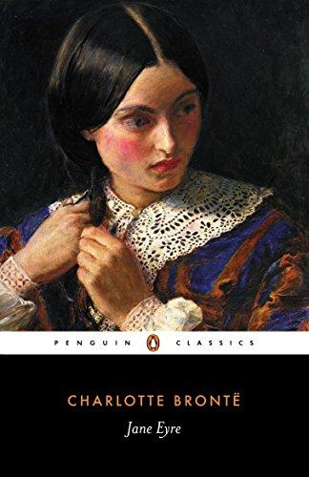
Mrs Reed has had enough of Jane. She is going to send Jane to school.
We are going to meet the headteacher of the school Jane will be sent to.
We will begin to discover how he will discipline Jane and make her a meek and submissive child.
Let’s read.
Recap
Read from, ‘I now stood in the empty hall…’ (page 38)
Read to, ‘…to carry on the conversation herself.’ (page 41)

Slide 5
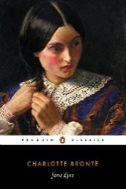
I now stood in the empty hall; before me was the breakfast-room door, and I stopped, intimidated and trembling. What a miserable little poltroon had fear, engendered of unjust punishment, made of me in those days! I feared to return to the nursery, and feared to go forward to the parlour; ten minutes I stood in agitated hesitation; the vehement ringing of the breakfast-room bell decided me; I must enter.
“Who could want me?” I asked inwardly, as with both hands I turned the stiff door-handle, which, for a second or two, resisted my efforts. “What should I see besides Aunt Reed in the apartment?—a man or a woman?” The handle turned, the door unclosed, and passing through and curtseying low, I looked up at—a black pillar!—such, at least, appeared to me, at first sight, the straight, narrow, sable-clad shape standing erect on the rug: the grim face at the top was like a carved mask, placed above the shaft by way of capital.
Mrs. Reed occupied her usual seat by the fireside; she made a signal to me to approach; I did so, and she introduced me to the stony stranger with the words:
poltroon – coward
engendered – caused by
vehement – angry
sable – fur
capital – strength
Jane Eyre
p.38

Slide 6
“This is the little girl respecting whom I applied to you.”
He, for it was a man, turned his head slowly towards where I stood, and having examined me with the two inquisitive-looking grey eyes which twinkled under a pair of bushy brows, said solemnly, and in a bass voice, “Her size is small: what is her age?”
“Ten years.”
“So much?” was the doubtful answer; and he prolonged his scrutiny for some minutes. Presently he addressed me—“Your name, little girl?”
“Jane Eyre, sir.”
In uttering these words I looked up: he seemed to me a tall gentleman; but then I was very little; his features were large, and they and all the lines of his frame were equally harsh and prim.
“Well, Jane Eyre, and are you a good child?”
Impossible to reply to this in the affirmative: my little world held a contrary opinion: I was silent. Mrs. Reed answered for me by an expressive shake of the head, adding soon, “Perhaps the less said on that subject the better, Mr. Brocklehurst.”
bass – low
prim – formal
affirmative – saying yes
Jane Eyre
p.38-39

Slide 7
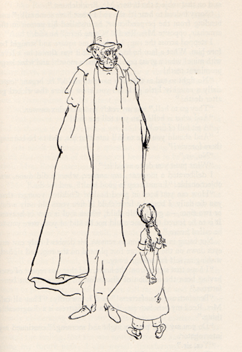
In uttering these words I looked up: he seemed to me a tall gentleman; but then I was very little; his features were large, and they and all the lines of his frame were equally harsh and prim.
Jane Eyre
p.38-39

Slide 8
“Sorry indeed to hear it! she and I must have some talk;” and bending from the perpendicular, he installed his person in the arm-chair opposite Mrs. Reed’s. “Come here,” he said.
I stepped across the rug; he placed me square and straight before him. What a face he had, now that it was almost on a level with mine! what a great nose! and what a mouth! and what large prominent teeth!
“No sight so sad as that of a naughty child,” he began, “especially a naughty little girl. Do you know where the wicked go after death?”
“They go to hell,” was my ready and orthodox answer.
“And what is hell? Can you tell me that?”
“A pit full of fire.”
“And should you like to fall into that pit, and to be burning there for ever?”
“No, sir.”
“What must you do to avoid it?”
I deliberated a moment; my answer, when it did come, was objectionable: “I must keep in good health, and not die.”
installed his person – sat down
orthodox – approved, expected
deliberated – paused
objectionable – incorrect, wrong
Jane Eyre
p.39-40

Slide 9
“How can you keep in good health? Children younger than you die daily. I buried a little child of five years old only a day or two since,—a good little child, whose soul is now in heaven. It is to be feared the same could not be said of you were you to be called hence.”
Not being in a condition to remove his doubt, I only cast my eyes down on the two large feet planted on the rug, and sighed, wishing myself far enough away.
“I hope that sigh is from the heart, and that you repent of ever having been the occasion of discomfort to your excellent benefactress.”
“Benefactress! benefactress!” said I inwardly: “they all call Mrs. Reed my benefactress; if so, a benefactress is a disagreeable thing.”
“Do you say your prayers night and morning?” continued my interrogator.
“Yes, sir.”
“Do you read your Bible?”
“Sometimes.”
“With pleasure? Are you fond of it?”
called hence – i.e. if Jane died, she would go to hell because she is wicked
repent – ask for forgiveness
benefactress – generous female financial supporter, i.e. Mrs Reed
Jane Eyre
p.40

Slide 10
“I like Revelations, and the book of Daniel, and Genesis and Samuel, and a little bit of Exodus, and some parts of Kings and Chronicles, and Job and Jonah.”
“And the Psalms? I hope you like them?”
“No, sir.”
“No? oh, shocking! I have a little boy, younger than you, who knows six Psalms by heart: and when
you ask him which he would rather have, a gingerbread-nut to eat or a verse of a Psalm to learn, he says: ‘Oh! the verse of a Psalm! angels sing Psalms;’ says he, ‘I wish to be a little angel here below;’ he then gets two nuts in recompense for his infant piety.”
“Psalms are not interesting,” I remarked.
“That proves you have a wicked heart; and you must pray to God to change it: to give you a new and clean one: to take away your heart of stone and give you a heart of flesh.”
I was about to propound a question, touching the manner in which that operation of changing my heart was to be performed, when Mrs. Reed interposed, telling me to sit down; she then proceeded to carry on the conversation herself.
Psalms – a book in the Bible made up of poems
recompense – reward
piety – faith
propound – ask
manner – way
Jane Eyre
p.40-41

Slide 11
Quick Check
Discuss the answers to these questions in pairs.
What does Mr Brocklehurst look like?
Mr Brocklehurst asks Jane how she could avoid going to hell. How does Jane respond?
What ‘proves’ that Jane has a ‘wicked heart’?
Quick Check

Slide 12
Quick Check
Mr Brocklehurst is tall, with bushy eyebrows and a large nose and teeth.
Jane says she can avoid going to hell by living for a long time and not dying!
Jane says that she doesn’t really like the Psalms, a book in the Bible. Even though she likes many of the books in the Bible, the fact that she doesn’t like the Psalms is meant to prove that she has a wicked heart.
Quick Check

Slide 13
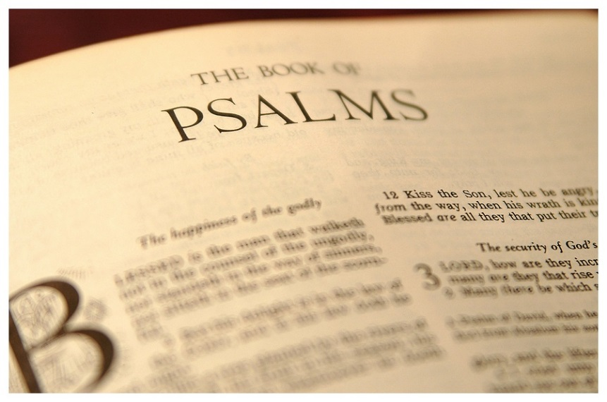
The Book of Psalms is a book of the Bible from the Old Testament.
It contains:
songs of praise for God's work in creation or in history,
Royal Psalms, dealing with such matters as the king's coronation, marriage and battles,
Laments, in which the nation laments (mourns) some shared disaster, and
Individual thanksgiving psalms, in which the psalmist thanks God for deliverance from personal distress.
Psalms
Think about the answers to these questions:
What kinds of story do we know Jane enjoys reading?
Why might Jane not enjoy reading the Psalms?

Slide 14
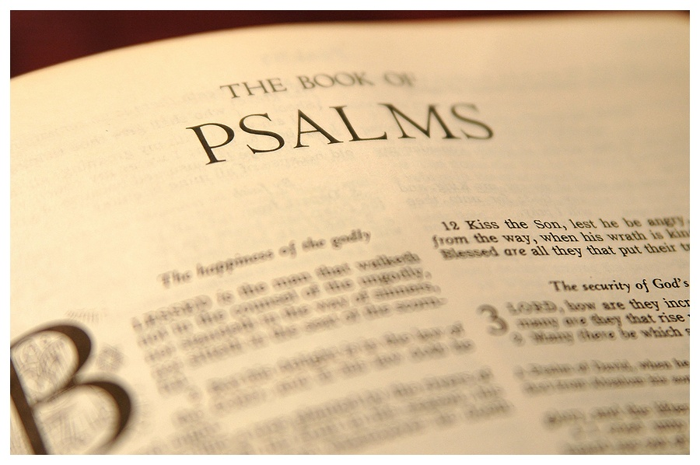
We know that Jane likes reading exciting adventure stories.
This might be why she doesn’t like reading the Psalms: they do not have any stories in them. Many other books of the Bible do contain stories, which is why Jane prefers reading them.
The Psalms tell people how to feel in certain situations. We know that Jane is a very passionate child, and would probably dislike being told how to feel!
These could all be reasons why Jane does not like reading the Psalms.
Psalms

Slide 15
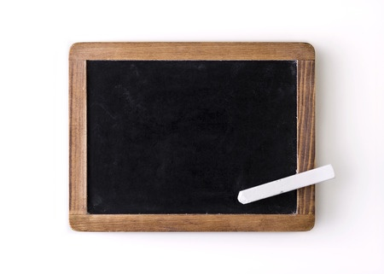
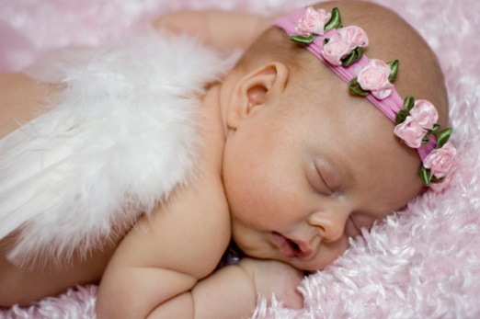
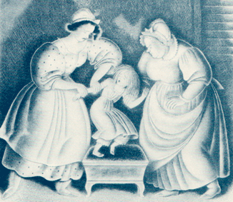
Attitudes towards raising children were very different in the Victorian era.
There were three main perspectives on raising a child the right way:
A child is a blank slate and can be trained to develop into a rational being.
Victorian childhood
A child is born completely innocent and pure. They are only contaminated by contact with corrupt forces.
The child is born evil and must therefore be controlled and punished in order to submit to the rules of God and society.

Slide 16
Which approach to raising a child does Mr Brocklehurst believe in?
With a partner, decide on your answer and find evidence from the passage we have just read.
A child is a blank slate and can be trained to develop into a rational being.
Victorian childhood
A child is born completely innocent and pure. They are only contaminated by contact with corrupt forces.
The child is born evil and must therefore be controlled and punished in order to submit to the rules of God and society.

Slide 17
Mr Brocklehurst believes that:
The child is born evil and must therefore be controlled and punished in order to submit to the rules of God and society.
Victorian childhood

Slide 18
Mrs Reed is glad to send Jane away to Mr Brocklehurst’s school.
Let’s finish reading the discussion between Mr Brocklehurst, Jane and Mrs Reed.
Jane Eyre
Read from, ‘“Mr. Brocklehurst, I believe I intimated in the letter…’” (page 41)
Read to, ‘…he departed.’ (page 43)

Slide 19
“Mr. Brocklehurst, I believe I intimated in the letter which I wrote to you three weeks ago, that this little girl has not quite the character and disposition I could wish: should you admit her into Lowood school, I should be glad if the superintendent and teachers were requested to keep a strict eye on her, and, above all, to guard against her worst fault, a tendency to deceit. I mention this in your hearing, Jane, that you may not attempt to impose on Mr. Brocklehurst.”
Well might I dread, well might I dislike Mrs. Reed; for it was her nature to wound me cruelly; never was I happy in her presence; however carefully I obeyed, however strenuously I strove to please her, my efforts were still repulsed and repaid by such sentences as the above. Now, uttered before a stranger, the accusation cut me to the heart; I dimly perceived that she was already obliterating hope from the new phase of existence which she destined me to enter; I felt, though I could not have expressed the feeling, that she was sowing aversion and unkindness along my future path; I saw myself transformed under Mr. Brocklehurst’s eye into an artful, noxious child, and what could I do to remedy the injury?
intimated – suggested
tendency to deceit – habit of lying
strove – tried
perceived – saw
obliterating – destroying
aversion – hate
noxious – poisonous
remedy – heal
Jane Eyre
p.41

Slide 20
“Nothing, indeed,” thought I, as I struggled to repress a sob, and hastily wiped away some tears, the impotent evidences of my anguish.
“Deceit is, indeed, a sad fault in a child,” said Mr. Brocklehurst; “it is akin to falsehood, and all liars will have their portion in the lake burning with fire and brimstone; she shall, however, be watched, Mrs. Reed. I will speak to Miss Temple and the teachers.”
“I should wish her to be brought up in a manner suiting her prospects,” continued my benefactress; “to be made useful, to be kept humble: as for the
vacations, she will, with your permission, spend them always at Lowood.”
anguish – sadness
the lake – i.e. hell
vacations – school holidays
Jane Eyre
p.41-42

Slide 21
“Your decisions are perfectly judicious, madam,” returned Mr. Brocklehurst. “Humility is a Christian grace, and one peculiarly appropriate to the pupils of Lowood; I, therefore, direct that especial care shall be bestowed on its cultivation amongst them. I have studied how best to mortify in them the worldly sentiment of pride; and, only the other day, I had a pleasing proof of my success. My second daughter, Augusta, went with her mama to visit the school, and on her return she exclaimed: ‘Oh, dear papa, how quiet and plain all the girls at Lowood look, with their hair combed behind their ears, and their long pinafores, and those little holland pockets outside their frocks—they are almost like poor people’s children! and,’ said she, ‘they looked at my dress and mama’s, as if they had never seen a silk gown before.’”
Jane Eyre
‘Your decisions...-…before.’ – Mr Brocklehurst agrees with Mrs Reed’s decision to ask that Jane stay at the school even during the holidays. He goes on to explain that he believes that being a true Christian means being humble and not wanted to have things that are enjoyable, pretty or fun. He feels that he has been successful in creating this belief in the pupils of his school because his daughter comments that the pupils look like poor people. Brocklehurst’s daughter also says that the pupils stared in amazement at her silk dress.
p.41-42

Slide 22
“This is the state of things I quite approve,” returned Mrs. Reed; “had I sought all England over, I could scarcely have found a system more exactly fitting a child like Jane Eyre. Consistency, my dear Mr. Brocklehurst; I advocate consistency in all things.”
“Consistency, madam, is the first of Christian duties; and it has been observed in every arrangement connected with the establishment of Lowood: plain fare, simple attire, unsophisticated accommodations, hardy and active habits; such is the order of the day in the house and its inhabitants.”
“Quite right, sir. I may then depend upon this child being received as a pupil at Lowood, and there being trained in conformity to her position and prospects?”
“Madam, you may: she shall be placed in that nursery of chosen plants, and I trust she will show herself grateful for the inestimable privilege of her election.”
“I will send her, then, as soon as possible, Mr. Brocklehurst; for, I assure you, I feel anxious to be relieved of a responsibility that was becoming too irksome.”
approve – agree with
consistency – things being the same
advocate – support
fare – food
attire – clothing
inestimable – immeasurable
election – chosen
irksome – annoying
Jane Eyre
p.42

Slide 23
“No doubt, no doubt, madam; and now I wish you good morning. I shall return to Brocklehurst Hall in the course of a week or two: my good friend, the Archdeacon, will not permit me to leave him sooner. I shall send Miss Temple notice that she is to expect a new girl, so that there will be no difficulty about receiving her. Good-bye.”
“Good-bye, Mr. Brocklehurst; remember me to Mrs. and Miss Brocklehurst, and to Augusta and Theodore, and Master Broughton Brocklehurst.”
“I will, madam. Little girl, here is a book entitled the ‘Child’s Guide,’ read it with prayer, especially that part containing ‘An account of the awfully sudden death of Martha G---, a naughty child addicted to falsehood and deceit.’”
With these words Mr. Brocklehurst put into my hand a thin pamphlet sewn in a cover, and having rung for his carriage, he departed.
pamphlet – booklet
Jane Eyre
p.42-43

Slide 24
“Deceit is, indeed, a sad fault in a child. all liars will have their portion in the lake burning with fire and brimstone”
“No sight so sad as that of a naughty child,” he began, “especially a naughty little girl.”
“You have a wicked heart; and you must pray to God to change it: to give you a new and clean one.”
Mr Brocklehurst
On your own, write an answer to this question:
What is Mr Brocklehurst’s attitude toward children?
Think about:
his Christian beliefs
his approach to discipline

Slide 25
Quiz time!
Circle the correct answers for quiz 2.
Fortnightly quiz

Slide 26
Quiz answers
b c
b c d
b e
d
a c d
a d e
d
a c
e
a c e
Answers

Slide 27
Love this lesson?
Have suggestions for improvements?
Does something need fixing?
Feedback
Please let us know!
Fill in this feedback form so that we can keep improving.

