Slide 1
Disabled
Wilfred Owen

Slide 2
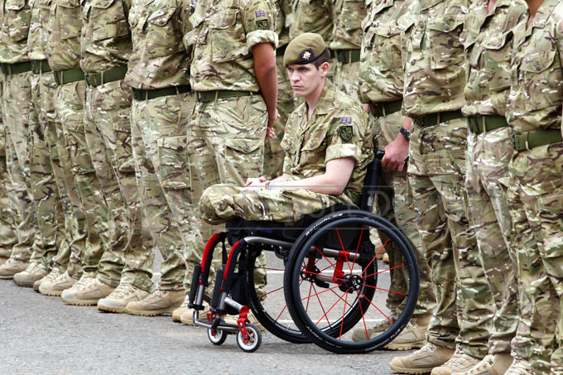

Slide 3
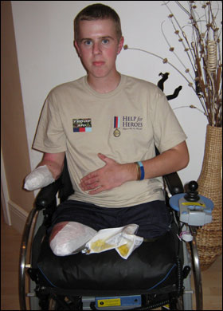
Sapper Matthew Weston
Sapper Matthew Weston lost his legs and his right arm as he tried to dispose of a Taliban bomb.
He has received abuse from strangers in the street, who have mocked his appearance.

Slide 4
What is the poem about?
A young man is sitting in a wheelchair in an institute for injured soldiers. It is early evening and he is waiting for the nurses to come and put him to bed.
He reflects on his life before the war and his life now that he is home, (the war is still ongoing). We learn that he was a popular young man and we guess that he must have been seventeen when he signed up. He recalls his sporting prowess and the reasons he signed up to the war.
He believed it to be an act of courage and heroism: he was told he’d look great in the uniform and the girls (including mothers, sisters, strangers, as well as girlfriends ‘Meg’) all encouraged him to go. He thought this would be a great adventure and an easy victory – like a football game. He looked forward to the money, the leave (during which he would be able to come home and impress everyone – particularly the girls) and the sense of pride.
We learn that he lost his limbs in a shell attack.
Now, as he sits in his wheelchair, we see that he has lost his youth. He is not an old man, but his experiences have cut his life short. Owen reveals the soldier’s thoughts – though he doesn’t give him a voice of his own. He laments the futility of war and realises what he has lost. He had been a virile and sexual young man, but now the women look at him without sexual or romantic interest.
As the children playing outside are called home by their mothers, he is left waiting for the nurses to arrive to put him to bed, but they do not come and he is left waiting, alone.

Slide 5
What is the meaning of the poem?
Through this poem Wilfred Owen conveys a bitter and stinging message to those people who encouraged young men to go and fight. The soldier’s loss is enormous and no one understands or appreciates his sacrifice; ‘Some cheered him home, but not as crowds cheer Goal’. He has not returned as a conventional ‘hero’ and he has become isolated; ‘Why don’t they come?’. He has lost his youth and his life; ‘Now, he is old’; he will never again live the life he once knew; ‘Now he will never feel again how slim Girls’ waists are’. The references to ‘dark’ and ‘bed’ could be a metaphor for death – he is waiting for this because his life is over, but he is even being deprived of that.

Slide 6
Structure
The structure of the poem is problematic. This is what Owen’s friend and fellow poet, Robert Graves had to say about it:
‘Owen, you have seen things; you are a poet; but you're a very careless one at present. One can't put in too many syllables into a line & say 'Oh, it's all right. That's my way of writing poetry'. One has to follow the rules of the meter one adopts.’
(letter from Robert Graves to Wilfred Owen, circa October 1917)
There is a fundamental sense of rhyme and rhythm, but it is inconsistent and flawed, as Graves observed. However, what does Owen achieve through this lack of order and precision?

Slide 7
Examples
Notice the caesura. This emphasises two things: that his arm is ‘sewn short’, but also that his life as a young man has also been cut short. There is a sense of finality; nothing can be done to change this. It is a blunt description of a tragic reality.
This first stanza is rigidly structured. The rhyme scheme is established; however, the lighter tone created by the rhythmical sounds of the poem contrasts with the subject matter.
He sat in a wheeled chair, waiting for dark, And shivered in his ghastly suit of grey, Legless, sewn short at elbow. Through the park Voices of boys rang saddening like a hymn, Voices of play and pleasure after day, Till gathering sleep had mothered them from him.

Slide 8
Examples
These stanzas in the middle of the poem are the longest in length, each comprising 8 lines.
The rhyme and rhythm – as well as length of the stanzas – convey the sense of enthusiasm, adrenaline and optimism the young soldier felt in his youth, and at the prospect of fighting in the war and returning home as a hero.
One time he liked a blood-smear down his leg, After the matches carried shoulder-high. It was after football, when he'd drunk a peg, He thought he'd better join. - He wonders why. Someone had said he'd look a god in kilts.
That's why; and maybe, too, to please his Meg, Aye, that was it, to please the giddy jilts, He asked to join. He didn't have to beg;
Smiling they wrote his lie; aged nineteen years. Germans he scarcely thought of; all their guilt,
And Austria’s, did not move him. And no fears Of Fear came yet. He thought of jewelled hilts For daggers in plaid socks; of smart salutes; And care of arms; and leave; and pay arrears; Esprit de corps; and hints for young recruits. And soon, he was drafted out with drums and cheers.
Notice the caesura: it comes twice after the word ‘join’ – thus implying that what seemed like a beginning (of an adventure; his journey into manhood) turned out to be an end.
The caesura in the second stanza creates a very ominous effect and conveys the young soldier’s naivety.
The regular rhyme scheme conveys just how easy it was for him to sign up. There is also a dull sense of inevitability.

Slide 9
Examples
This is the shortest stanza and it is perhaps the most bitter and resentful of all. We can almost hear Owen spitting these lines.
Some cheered him home, but not as crowds cheer Goal. Only a solemn man who brought him fruits Thanked him; and then enquired about his soul.
The ‘solemn man’ is particularly interesting. Fruit is often taken to patients by visitors. The italicised ‘Thanked’ implies Owen (and the young soldier) resent this gesture. The man clearly has no idea of what the young man has been through. Why do you think he ‘enquired about his soul’?
The brevity of the stanza reinforces the sense of loss and futility. The hope of glory that the young soldier anticipated in the last stanza has vanished.

Slide 10
Examples
The caesura here could suggest that he has been left alone for a long time. He has been forgotten and neglected.
The repetition of the rhetorical question depicts the soldier’s loneliness, isolation, vulnerability and lack of independence.
How cold and late it is! Why don't they come And put him into bed? Why don't they come?
The final stanza utilises a rhyming couplet – and it is the only one to do so.

