Slide 1
Act 1, scenes 4 and 5

Slide 2
Aims
Analyse and explore the role of the ghost in ‘Hamlet’
Come to a judgement that is informed by the interpretations of others

Slide 3
In ‘my mind’s eye’ 1.2.183-185
HAMLET: My father, me thinks I see my father.
HORATIO: Where, my Lord?
HAMLET: In my mind’s eye, Horatio.

Slide 4
Why are these important quotes from 1.4?
‘some vicious mole of nature’
‘questionable shape’
‘Be thou a spirit of health, or goblin damned,
Bring with the airs from heaven or blasts from hell,
Be thy intent wicked or charitable?
‘Say, why is this? Wherefore? What should we do?’
‘What if it tempt you to the flood, my Lord/ Or to the dreadful summit of a cliff?’
‘My fate cries out.’

Slide 5
Significant parts: 1.4
Hamlet reflects that ‘some vicious mole of nature’ can overwhelm reason and dignity – links to the notion of tragedy – where the cause of a tragedy is a result of a flaw in a character.
Hamlet sees the ghost as a ‘questionable shape’: is it good or evil?
Uncertainty – is the ghost an agent of the God or the Devil?
‘Be thou a spirit of health, or goblin damned,
Bring with the airs from heaven or blasts from hell,
Be thy intent wicked or charitable?
‘Say, why is this? Wherefore? What should we do?’
Metaphorical warnings: ‘What if it tempt you to the flood, my Lord/ Or to the dreadful summit of a cliff?’
In spite of warnings, Hamlet follows the ghost, claiming, ‘My fate cries out.’ – creates a sense of tragic inevitability – beyond his control

Slide 6
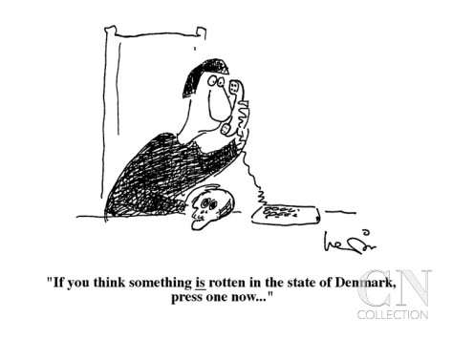
A05: CRITICAL INTEPRETATION
Throughout Hamlet the recurring images of disease and corruption help establish the fact that ‘something is rotten in the state of Denmark.’
A literary critic, Caroline Spurgeon, in her study of image clusters in Shakespeare said that the distinctive atmosphere of the play is:
‘partly due to the number of images of sickness, disease or blemish of the body… the idea of an ulcer or tumour, as descriptive of the unwholesome condition of Denmark, morally, that is the dominating one.’
QUESTION: What are the corrupt/ immoral aspects of Denmark so far?

Slide 7
1.5 Interpreting the ghost
‘Who’s there? Hamlet famously begins. The question, centred on the ambiguous figure of the Ghost, haunts the entire play.’ (Stephen Greenblatt)
t

Slide 8
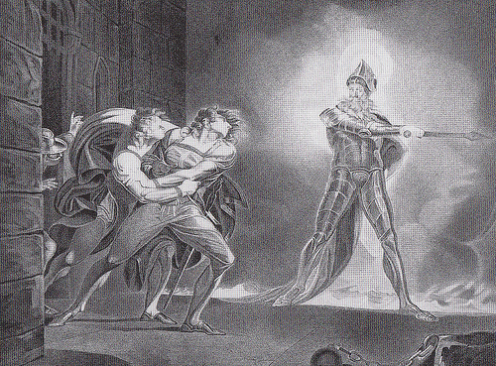
1.5 Interpreting the ghost
Ghost a typical feature of traditional revenge tragedies from this period: called the hero to revenge. Shakespeare begins to subvert/explore this genre later as Hamlet questions the morality/ ethics of what the ghost is asking him to do.
Ghost’s language creates a sense of torment and agony – graphic phrases evoke fear and disgust and the corruption of bodily decay: ‘harrow up thy soul, freeze thy young blood’; ‘vile and loathsome crust’
t
PS. Subvert - undermine the power and authority of (an established system or institution).

Slide 9
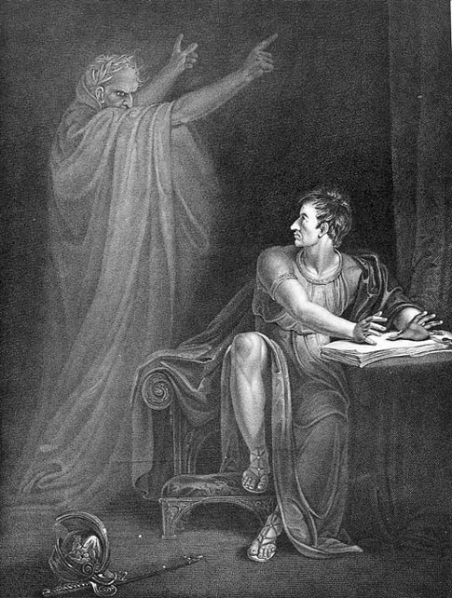
1.5 Interpreting the ghost
In Shakespeare’s time, audiences would realise that the Ghost suffers terrible agonies because he is in Purgatory (between Heaven and Hell):
Roman Catholics – where sinners who died went before confession; in purgatory their sins would be burnt and purged away
Protestants – didn’t believe in purgatory (Protestantism had abolished it), but would suspect the Ghost as being an evil agent of the devil
Suspicion of the ghost further prompted by Ghost’s call for revenge as revenge forbidden by State and the Church: ghost as a devilish spirit sent to tempt Hamlet into an action that will result in his suffering for all eternity.

Slide 10
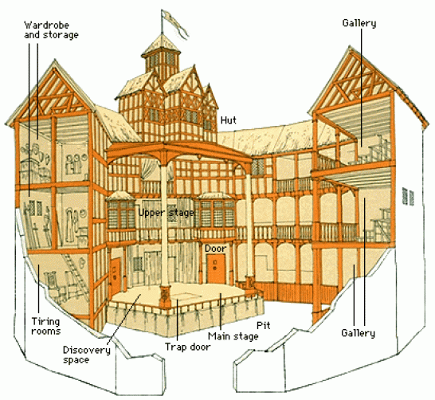
1.5 Interpreting the ghost
‘Heavens’ – roof of the stage
‘Hell’ – below the stage

Slide 11
Using an interpretation to discuss the play
National Theatre production, directed by Lyndsey Turner, Benedict Cumberbatch playing Hamlet – in discussion with Melvyn Bragg
‘transgenerational trauma’ – notion of the older generation inflicting their views on the younger (3.00-8:05 mins)
interpreting the ghost in light of this idea (12.00-18.00 mins)
https://www.youtube.com/watch?time_continue=1063&v=l0ky_tQxwgo
Notes:
Y12 wed – watch interpreting the ghost piece

Slide 12
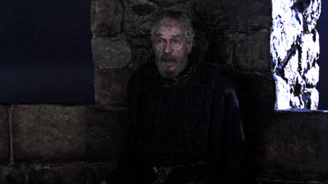
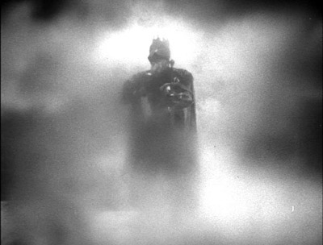
AO5: Interpretations of ghost
https://www.youtube.com/watch?v=Hjx_ihCkA38 (Olivier, 1948)
https://www.youtube.com/watch?v=vZQ5ryS-YvM (Zefferelli, 1990)
As you watch…
How do these two directors/actors interpret the ghost? Differences/ similarities?
Which do you think is more true to the text/ how you interpreted it?
What other ways might you interpret the ghost if you were directing your own Hamlet?

Slide 13
1.5 Hamlet’s final words
What is Hamlet telling Horatio here?
‘And therefore as a stranger give it welcome:
There are more things dreamt of in heaven and earth, Horatio,
Than are dreamt of in your philosophy.’
‘As I perchance hereafter shall think meet
To put an antic disposition on’
‘This time is out of joint; O cursed spite
That I was ever born to set it right!’
The ‘antic disposition’ is the reference to the madness. What will be the effect on the audience for the rest of the play now Hamlet has said this?
Personal troubles become public: Hamlet as the revenger who will cure the ills of his family but also of Denmark… what’s the effect of the rhyming couplet?

