Slide 1
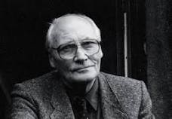
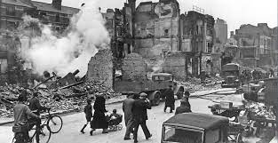
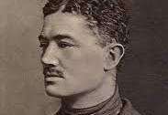
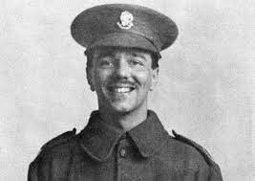
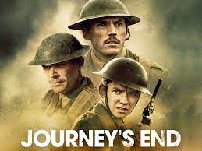
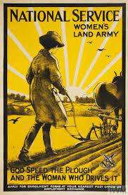
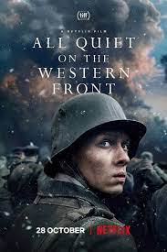
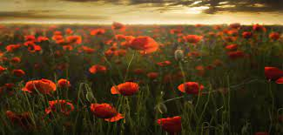
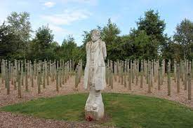
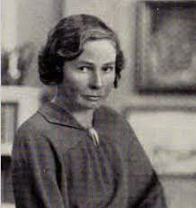
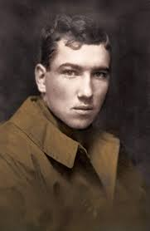
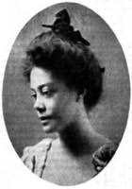
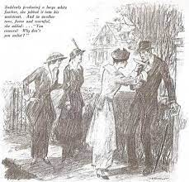
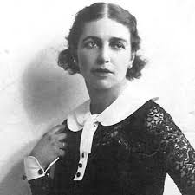
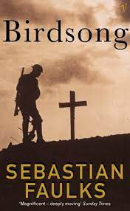
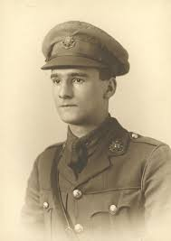
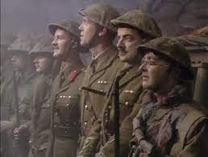
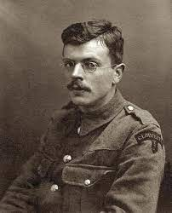
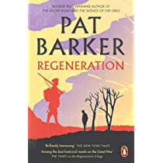
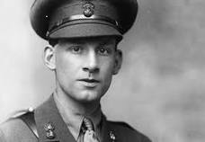
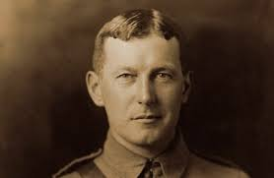
Year 9 English
Michaelmas Term
War Writing

Slide 2
WEEK 1: Y9 WAR WRITING
Key questions | Core knowledge | Terminology & vocabulary | Discussion, reading & writing
Big questions: Is war a suitable subject for literature? How do different forms of literature change our perceptions of war? Key questions: When did World War 1 take place? How were women’s experiences of WW1 different to men’s? (Home front vs the front) | World War 1 – 1914-1918 Many of the works during and about the war were written by men because of the war's intense demand on the young men of that generation; however, a number of women created literature about the war, often observing the effects of the war on soldiers, domestic spaces, and the Homefront more generally. The spread of education in Britain in the decades leading up to World War I meant that British soldiers and the British public of all classes were literate. Professional and amateur authors were prolific during and after the war and found a market for their works Texts: Julian Grenfell’s ‘Into Battle’ Sassoon’s The General’ Owen’s Anthem for Doomed Youth McCrae’s ‘In Flanders Field’ Jesse Pope’s ‘Who’s for the Game?’ Margaret Postgate Cole’s ‘The Falling Leaves’ Lois Clarke’s ‘Picture from the Blitz’. Extracts from Faulkner’s Birdsong Extract from Barker’s Regeneration Extract from Blackadder Goes Fourth | Terminology sonnet scene dialogue Vocabulary conflict glory patriotism courage incompetent | Structured discussions: What are the differences between poetry, prose and plays? Couch to 5 k writing: How do writers present attitudes to war? How are plays different to other literary forms? Rewrite 1 of the poems as a prose description. Reading fluency: Any of the poems
Expert knowledge Literature was produced throughout the war - with women, as well as men, feeling the need to record their experiences- but it was in the late 1920s and early 1930s that Britain had a boom in publication of war literature. Published poets wrote over two thousand poems about and during the war. However, only a small fraction still is known today, and several poets that were popular with contemporary readers are now obscure. An orthodox selection of poets and poems emerged during the 1960s, which often remains the standard in modern collections and distorts the impression of World War I poetry. This selection tends to emphasise the horror of war, suffering, tragedy and anger against those that wage war. Wilfred Owen was killed in battle; but his poems created at the front did achieve popular attention after the war's end. In preparing for the publication of his collected poems, Owen tried to explain: “This book is not about heroes. English poetry is not yet fit to speak of them. Nor is it about deeds, or lands, nor anything about glory, honour, might, majesty, dominion, or power, except War. Above all I am not concerned with Poetry. My subject is War, and the pity of War. The Poetry is in the pity.”

Slide 3
Year 9 English
Michaelmas Term
War Writing
Week 1, Lesson 1
Aim: Today will we be introduced to a sample of WW1 poetry to examine the different approaches poets have used to describe their experiences of war.

Slide 4
Brainstorm:
Glory
Conflict

Slide 5
Link to Bodleian Library resources on Literature of WW1: https://libguides.bodleian.ox.ac.uk/ww1-sources/literature
BBC Bitesized:
https://www.bbc.co.uk/bitesize/topics/z4crd2p
What do we already know about World War I?
Youtube Video (10mins):
https://youtu.be/OGfAf45ddCo
Imperial War Museum Link to Summary:
https://www.iwm.org.uk/history/5-things-you-need-to-know-about-the-first-world-war

Slide 6
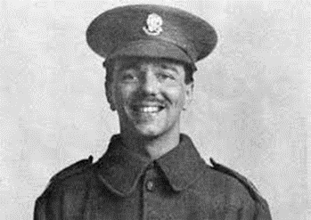
Task 1:
With the ideas we’ve discussed about ‘Conflict’ and ‘Glory’ in mind, let’s read the following poems and think about the similarities between them:
Julian Grenfell: ‘Into Battle’ p.8
Seigfried Sassoon: The General’ p.9
Wilfred Owen: ‘Anthem for Doomed Youth’ p.10
John McCrae: ‘In Flanders Field’ p.11
Task 2:
Which is ‘best’? Why?
Task 3:
Select one poem and devise 3 questions for the poet of your chosen poem (e.g. what is it about? why did you write it? What did you mean by …?)
Discuss the answers to some of these questions.
Task 4:
Now let’s check your understanding:
Which poems do the following lines come from:
“O patient eyes, courageous hearts!”
“most of 'em dead”
“The pallor of girls’ brows shall be their pall”
“We shall not sleep, though poppies grow”
Explain how you know….

Slide 7
Discussion:How should poets write about war?
...also, why do soldiers write poems?
​Although ‘war poet’ tends traditionally to refer to active combatants, war poetry has been written by many ‘civilians’ caught up in conflict in other ways.
​
In the global, ‘total war’ of 1939-45, that saw the holocaust, the blitz and Hiroshima, virtually no poet was untouched by the experience of war.
The same was true for the civil conflicts and revolutions in Spain and Eastern Europe.
That does not mean, however, that every poet responded to war by writing directly about it. For some, the proper response of a poet was one of consciously (conscientiously) keeping silent.​
Poets have written about the experience of war since the Greeks, but the young soldier poets of the First World War established war poetry as a literary genre.
In 1914 hundreds of young men in uniform took to writing poetry as a way of striving to express extreme emotion at the very edge of experience.

Slide 8
Describe the conditions for soldiers during WW1
Last Scene:

Slide 9
​Wilfred Owen wrote that even Shakespeare seems ‘vapid’ after Sassoon: ‘not of course because Sassoon is a greater artist, but because of the subjects’.​​
War poetry is not necessarily ‘anti-war’. It is, however, about the very large questions of life: identity, innocence, guilt, loyalty, courage, compassion, humanity, duty, desire, death.
Its response to these questions, and its relation of immediate personal experience to moments of national and international crisis, gives war poetry an extra-literary importance.​

Slide 10
Task: Describe the conditions for soldiers during WW1
Let loose sentence
There was a sudden warmth to the deep blackness that held me, the glossy tree trunks, the criss-crossing of a million dark branches, the thicker boughs barring my way, the undersides of the leaves obscuring the sun, and the crowns of all the trees flickering in the light of a faraway day.
Semi colon split
The birds had long since disappeared; there was no open space for even the smallest of birds.
Simile start
Like a bird knocked out of the sky, I was thrown to the ground as though for the last time.
Adjective attack
Steep and intimidating, the sudden rise of the forest floor ahead of me caused me to pause.
End loaded sentence
After having walked for several hours, getting more and more lost, only losing my way again and again, the choice of paths filled me with dread.

Slide 11
Task: Describe the conditions for soldiers during WW1
Let loose sentence
There was a sudden warmth to the deep blackness that held me, the glossy tree trunks, the criss-crossing of a million dark branches, the thicker boughs barring my way, the undersides of the leaves obscuring the sun, and the crowns of all the trees flickering in the light of a faraway day.
Category | Vocabulary
Atmospheric Elements | Atmosphere
Visual Descriptors | Radiant, Vivid, Lustrous, Brilliant, Dazzling, Glowing, Glimmering, Sparkling, Shimmering, Twinkling
Natural Elements | Forest
Trees and Vegetation | Foliage, Canopy, Thicket, Underbrush, Leaves, Branches, Boughs, Trunks, Vines, Moss
Light and Shadow | Sunlight, Sunbeams, Shadows, Gleam, Ray, Illumination, Dappled, Sun-drenched, Penetrating, Shaded
Sensations | Warmth, Chill, Tingle, Embrace, Caress, Envelop, Engulf, Embrace, Cradle, Hug
Spatial Relationships | Surroundings, Enclosure, Encompass, Envelop, Contain, Embrace, Embody, Occupy, Enshroud, Enfold

Slide 12
Task: Describe the conditions for soldiers during WW1
Semi colon split
The birds had long since disappeared; there was no open space for even the smallest of birds.
Images and Words for ideas:
Dying embers
Fading sunset
Withered roses
Abandoned dreams
Broken wings
Shattered glass
Lost hope
Crumbling ruins
Forgotten memories
Silent echoes

Slide 13
Task: Describe the conditions for soldiers during WW1
Simile start
Like a bird knocked out of the sky, I was thrown to the ground as though for the last time.
Ideas Bank:
1. Falling star
2. Plummeting anchor
3. Tumbling leaf
4. Sinking ship
5. Shattered dreams
6. Vanishing hope
7. Broken wings
8. Crashing waves
9. Lost in the abyss
10. Sudden descent

Slide 14
Task: Describe the conditions for soldiers during WW1
Ideas Bank:
1.Chilling and ominous,
2. Frozen and forbidding,
3. Grim and haunting,
4. Unyielding and cold,
5. Ominous and shrouded,

Slide 15
Words and Phrases:
Prolonged struggle
Relentless adversity
Endless challenges
Perpetual anxiety
Persistent fear
Unceasing dread
Ongoing hardship
Daily uncertainty
Constant vigilance
Unyielding exhaustion
Images:
Worn-out soldiers on a battlefield
A marathon runner nearing the finish line
A weary traveller searching for shelter
An aging tree weathering countless storms
A fragile bridge on the verge of collapse
A candle flickering in the wind
A tightrope walker balancing on a thin wire
A crumbling sandcastle on the shore
A fragile spiderweb glistening with dew
An overworked machine with smoking gears
End loaded sentence
After having walked for several hours, getting more and more lost, only losing my way again and again, the choice of paths filled me with dread.

Slide 16
Describe the conditions for soldiers during WW1
Model: ​
It had all become normal, the constant thundering of the guns, the cold shivering into our bones, our bodies itching with filth and lice, the moaning of the wondered and the stench of the dead, all a normal part of life.
A sad sort of life; more like living death.
Like men dying of thirst, we drank down every last moment of peace and comfort.
Cold and forbidding, we knew death was around every corner.
After months of hardship, jumping at every break in the routine, soaked with the dread that each day would be our last, we were exhausted by the nearness of sudden and violent death.

Slide 17
Year 9 English
Michaelmas Term
War Writing
Week 1, Lesson 2
Aim: To compare the ways men and women approach writing about war.

Slide 18
‘Do now’ Task: Recap prior knowledge:
What type of poem is Anthem for Doomed Youth?
When did John McCrae die?
Name one of Siegfried Sassoon’s poems
What was Julian Grenfell’s attitude to war?
What does ‘conflict’ mean?

Slide 19
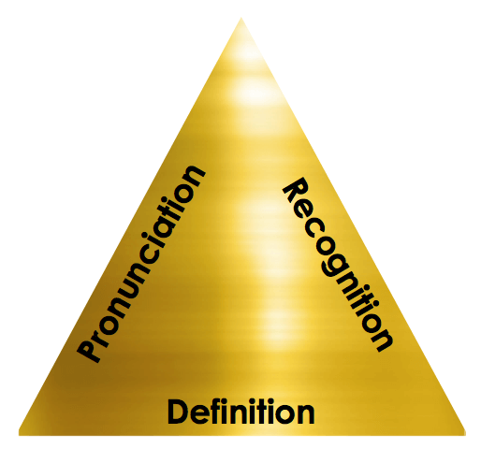
Myth/Mythology
Deity
Cosmogony
Pantheon
Polytheism
Vocabulary Learning
Pronunciation – how is the word is said. If you say it aloud and use it in a sentence, it will help you remember it.
Recognition – how is the word spelt? Being able to use phonics to decode new vocabulary and then to be able to reproduce the spelling makes a dig difference.
Definition – what does the word mean? It might sound obvious, but if you know the meaning of a word, you’re much more likely to remember it.

Slide 20
Vocabulary learning (link to David Didau N:\Word of the week - innovation (David Didau).mp4) 1. Say new word, display on screen 2. Say new word in a few different sentences 3. Pronunciation (1): Use phonetical spelling to show how to pronounce word 4. Recognition (2): Spell word, broken down into logical sections. 5. Definition (3): Use synonyms. 6. Etymology 7. Related Words

Slide 21
Sonnet
Scene
Dialogue
Conflict
Glory
Patriotism
Courage
Incompetent
Vocabulary Learning
Patriotism
Rate how well you know it:
Never seen it before
Seen it, heard it, unsure what it means
Understand and can sometimes use
Confidently understand and can explain

Slide 22
New Word:
Patriotism
Spell It:
Say It!
“Mith”
My-th
Etymology:
Ancient Greek μῦθος (mûthos, “word, humour, companion, speech, account, rumour, fable”)
Understand it Definition: A story or tale
Word Class: Noun
Example: “Most societies have their own creation myths.”

Slide 23
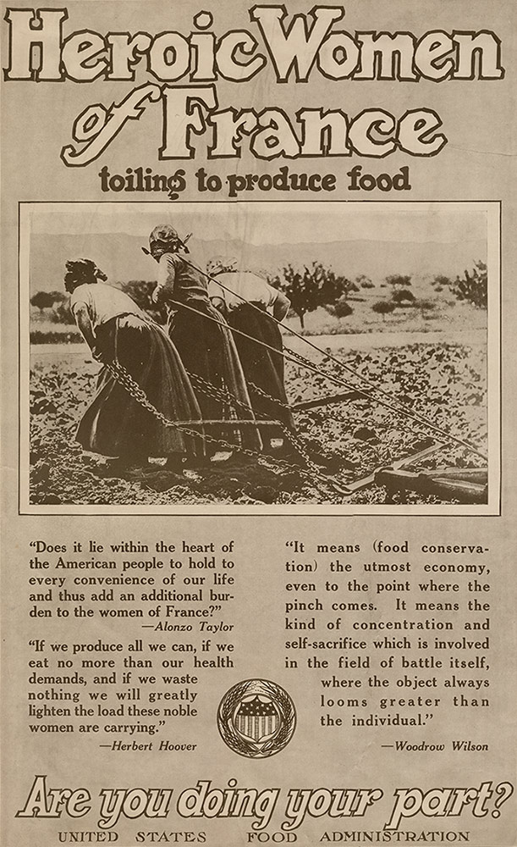
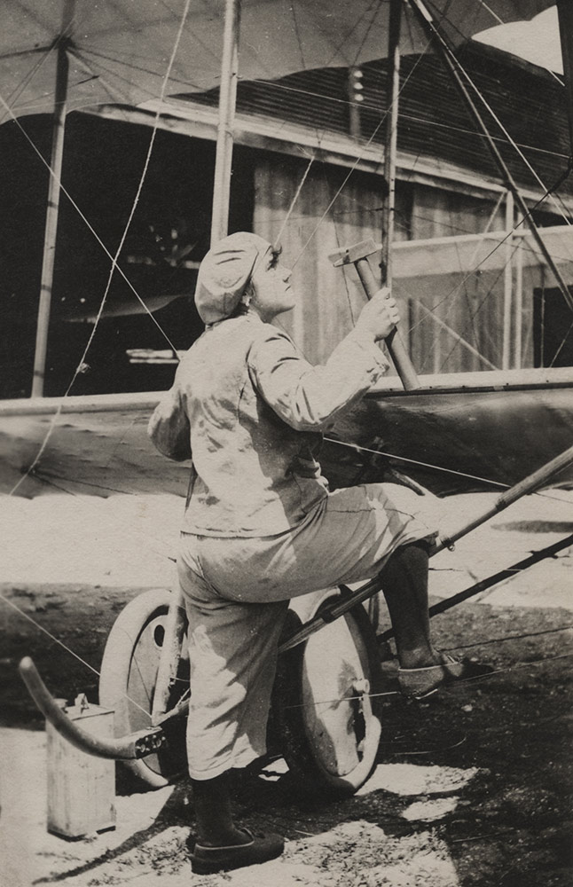
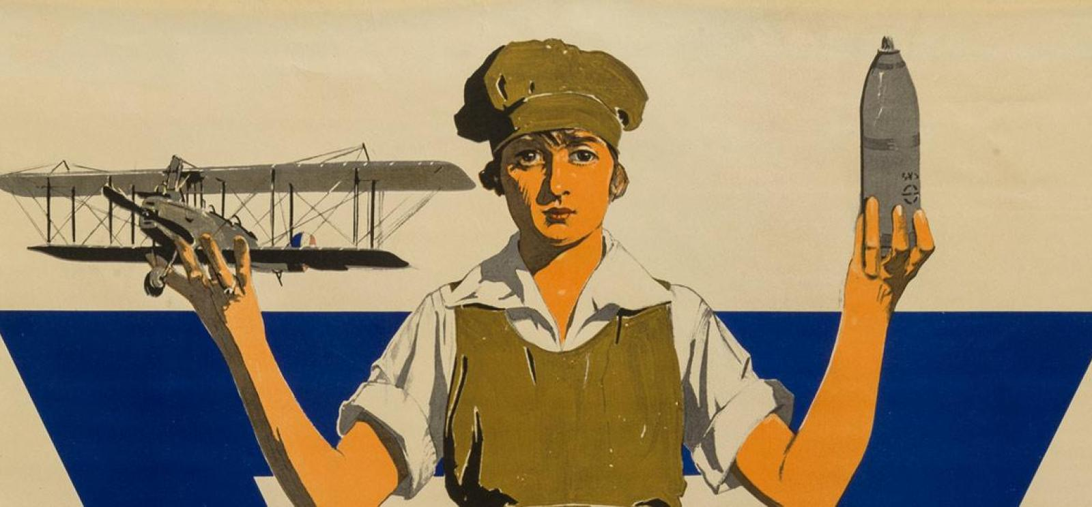
How was women’s experience of WW1 different to men’s? https://www.bbc.co.uk/teach/class-clips-video/history-ks3-ks4-world-war-one-work-for-women/zmjpgwx
(Home front vs the front)
https://www.theworldwar.org/learn/women
https://www.iwm.org.uk/history/did-the-first-world-war-transform-womens-lives
https://www.bl.uk/world-war-one/articles/women-at-home
https://www.nationalww2museum.org/war/articles/gender-home-front

Slide 24
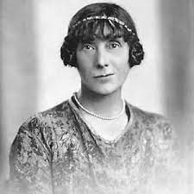
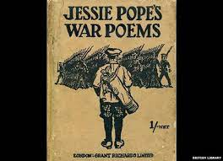
Let’s read:
Jesse Pope’s ‘Who’s for the Game?’ p.12
Margaret Postgate Cole’s ‘The Falling Leaves’ p.13
Lois Clarke’s ‘Picture from the Blitz’ p.14
Discuss: do men and women write differently about war?

Slide 25
He's gone, and all our plans
Are useless indeed.
We'll walk no more on Cotswold
Where the sheep feed
Quietly and take no heed.
His body that was so quick
Is not as you
Knew it, on Severn river
Under the blue
Driving our small boat through.
You would not know him now ...
But still he died
Nobly, so cover him over
With violets of pride
Purple from Severn side.
Cover him, cover him soon!
And with thick-set
Masses of memoried flowers—
Hide that red wet
Thing I must somehow forget.
…does this poem feel like it’s written by a man or woman?
Why?

Slide 26
Comparing Male and Female Writing About War
Written Task
Sentence expanding:
Men and women wrote differently about WW1 because [provide a reason]
Men and women wrote differently about WW1 but [suggest a similarity]
Men and women wrote differently about WW1 so [explain how this might affect our views of the poetry written by men and women]

Slide 27
'All' Exemplar:
Men and women wrote differently about WW1 because they had different roles during the war. Men were often soldiers on the frontlines, while women were usually at home or in supportive roles. These roles shaped their experiences and how they wrote about them.
Men and women wrote differently about WW1 but they both felt the emotional toll of the war. Even though their experiences were different, both genders were deeply affected by the war's hardships, and this shared emotional aspect connects their writings.
Men and women wrote differently about WW1 so understanding these gender differences helps us appreciate their poetry better. Men's poems often focus on the harsh realities of war, while women's writings shed light on the challenges they faced on the home front. Recognising both perspectives gives us a more complete picture of WW1's impact and enriches our understanding of its literary legacy.

Slide 28
'Some' EXEMPLAR: Men and women wrote differently about WW1 because their unique societal roles and perspectives influenced their experiences during the war. While men primarily served on the frontlines, women often played supportive roles on the home front, such as nurses, factory workers, or those left behind to manage households. These distinct roles led to different wartime encounters, which in turn shaped their literary responses.
Men and women wrote differently about WW1 but shared a common underlying theme of emotional turmoil. Despite the differences in their experiences, both genders grappled with the devastating effects of the war on their lives and the lives of their loved ones. This shared emotional resonance underscores the universality of the human experience during times of conflict, transcending gender boundaries.
Men and women wrote differently about WW1 so understanding these gendered perspectives enriches our appreciation of the poetry from this era. The poems by men often depict the horrors of battle, the camaraderie among soldiers, and the disillusionment with war's brutality. On the other hand, women's writings, often overlooked in historical accounts, provide insights into the resilience, sacrifices, and emotional hardships faced on the home front. Recognising these distinct viewpoints broadens our comprehension of the multifaceted impact of WW1, fostering a more holistic understanding of the war's literary legacy. By embracing both male and female perspectives, we gain a deeper insight into the human condition during one of the most tumultuous periods in history.

Slide 29
Year 9 English
Michaelmas Term
War Writing
Week 1, Lesson 3
Aim: To compare some of the differences in the ways writers express ideas in poetry and prose

Slide 30
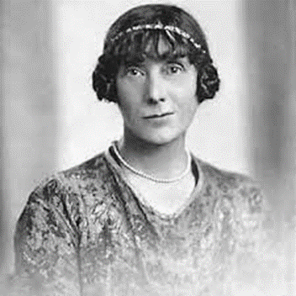
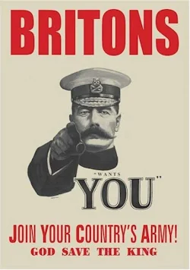
Recap:
What’s the title of Jessie Pope’s most famous poem?
Which poem was set in WW2?
What word class is ‘courageous?
What does glory mean?
Which poems display patriotism?

Slide 31
Sonnet
Scene
Dialogue
Conflict
Glory
Patriotism
Courage
Incompetent
Vocabulary Learning
Courage
Rate how well you know it:
Never seen it before
Seen it, heard it, unsure what it means
Understand and can sometimes use
Confidently understand and can explain

Slide 32
New Word:
Courage
Spell It:
Say It!
“Curidge”
Cou-rage
Etymology:
Middle English (denoting the heart, as the seat of feelings): from Old French corage, from Latin cor ‘heart’.
Understand it Definition: the ability to do something that frightens one; bravery.Word Class: Noun
Example: "she called on all her courage to face the ordeal"

Slide 33
Questions
What similarities are there between this extract from Regeneration and the extract from Birdsong? What is different?
Can you find any similarities with the opening stage directions from Journey’s End?
p.16
p.18

Slide 34
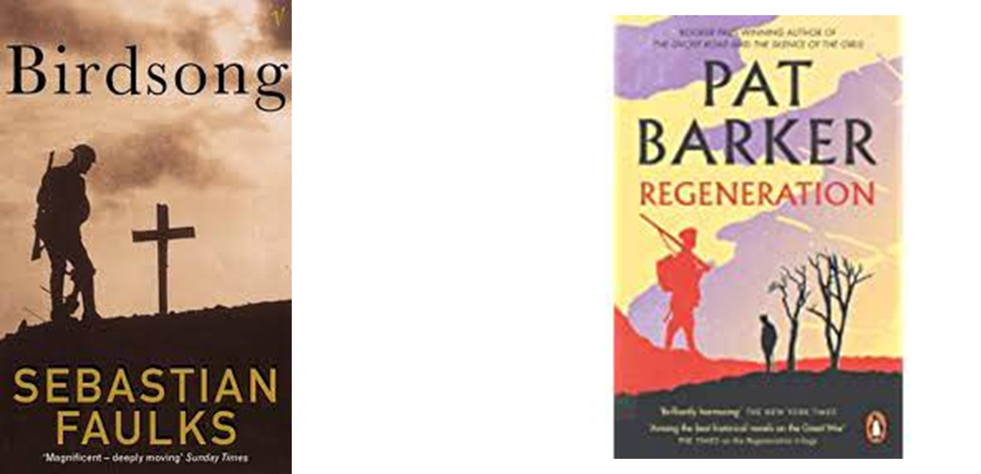
“How do writers present attitudes to war?”
Write a single sentence thesis statement.
Model: “Although Faulks depicts war as __________, in Grenfell’s poem ‘Into Battle’ it is presented as ________.”
(The subordinating conjunction signals a change in direction and the comma pivots between contrasting ideas)
Now you suggest ideas to fill in the subordinate and main clauses.:

Slide 35
Now you write your own one sentence thesis statement for the question:
“Compare how war is presented in two different literary forms.”
Your answer must begin with:
“Although…” subordinate clause = presentation of war in Birdsong; main clause = presentation of war in one of the poems.

Slide 36
Year 9 English
Michaelmas Term
War Writing
Week 1, Lesson 4
Aim: To introduce the differences between the play form and other forms of literature

Slide 37
Recap:
Give an example of a subordinating conjunction
What is ‘prose’?
What does ‘patriotism’ mean?
Who wrote ‘Anthem for Doomed Youth’?
What is a thesis statement?

Slide 38
Sonnet
Scene
Dialogue
Conflict
Glory
Patriotism
Courage
Incompetent
Vocabulary Learning
Incompetent
Rate how well you know it:
Never seen it before
Seen it, heard it, unsure what it means
Understand and can sometimes use
Confidently understand and can explain

Slide 39
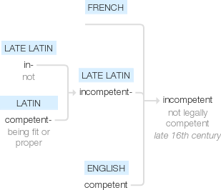
New Word:
Incompetent
Spell It:
Say It!
Etymology:
Late 16th century (in the sense ‘not legally competent’): from French, or from late Latin incompetent-, from in- ‘not’ + Latin competent- ‘being fit or proper’
“In-comp-y-tent”
In-comp-e-tent
Understand it
Definition: not having or showing the necessary skills to do something successfully.
Word Class: Adjective
Example: "a forgetful and utterly incompetent assistant"

Slide 40
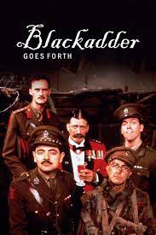
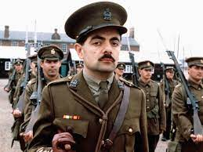
P.19
Novels and poems are able to present us with horror very differently – by getting readers to focus on external descriptions and internalised emotional reactions. Here everything has to be conveyed through tone of voice and visual action

Slide 41
Task:
Write a one sentence thesis statement for the question:
“How are plays different to other literary forms?”
Your answer must start with the subordinating conjunction ‘Because’

Slide 42
Now combine the following 3 sentences into one sentence:
Plays are divided into scenes and acts.
Plays include stage directions to instruct actors on how to perform lines.
Plays mainly consist of the dialogue spoken by actors.

Slide 43
Rewrite 1 of the poems as a prose description.
Let loose sentence
There was a sudden warmth to the deep blackness that held me, the glossy tree trunks, the criss-crossing of a million dark branches, the thicker boughs barring my way, the undersides of the leaves obscuring the sun, and the crowns of all the trees flickering in the light of a faraway day.
Semi colon split
The birds had long since disappeared; there was no open space for even the smallest of birds.
Simile start
Like a bird knocked out of the sky, I was thrown to the ground as though for the last time.
Adjective attack
Steep and intimidating, the sudden rise of the forest floor ahead of me caused me to pause.
End loaded sentence
After having walked for several hours, getting more and more lost, only losing my way again and again, the choice of paths filled me with dread.

Slide 44
Extension: Additional Reading
There is more to war poetry than mud, wire and slaughter
Andrew Motion https://www.theguardian.com/books/2016/jul/09/andrew-motion-definition-war-poetry-widen-not-just-first-world-war
Introduction to First World War Plays
Mark Rawlinson
The First World War is often recalled as a war of numbers which overwhelm the imagination: 16 million dead, including 6 million excess civilian deaths. 8.7 million men from the British Empire served in the army at some time during 1914-18; nearly a million were killed, died of wounds or were missing – 700,000 of them were from the British Isles. On over 2 million occasions British Army soldiers were wounded and on 64% of these occasions the men were returned to active service to be exposed to more violence. Sixteen thousand men claimed the right to exemption from military service as conscientious objectors to taking part in the killing of people. Three hundred and six British servicemen were executed for cowardice or desertion, for refusing to kill people. (They were pardoned in 2006.) Memorialising the war and its victims was the work of decades. The War Graves Commission was founded in 1917 – its largest memorial, at Theipval, records 72,000 names, and its largest cemetery contains 12,000 graves. By 1972, more than 500 cemeteries on the Western Front were complete and well over 400,000 headstones had been erected.
The war also had a huge literary impact. 2,225 English poets wrote verse about the war of 1914-18. Erich Maria Remarque’s All Quiet On The Western Front (1929) sold more than 2 million copies in little over a year. RC Sherriff’s play Journey’s End (1928) played for 2 years but there were 65 other plays written by 1918 and nearly 100 more by 1939.

Slide 45
Extension: Additional Reading Continued
Theatre of War
The irony of the phrase ‘theatre of war’ should be obvious. One of the main reasons why ‘theatre’ and modern war seem so connected is that modern wars are fought by conscripted armies, whose members knew they were only temporarily playing ill-learned parts.
This association became stronger in the 1920s. Writing about the impact of Journey’s End in creating what he called a ‘myth of war,’ Samuel Hayes wrote:
Sherriff’s play had another quality that guaranteed its success: in his effort to render the reality of the Front, Sherriff had collected the basic elements of the Myth. The characters are the stock figures of the war stories – the brave, hard-drinking commander, the steady second-in-command, the innocent new lieutenant, the coward, the lower-class New Army officer, even the comic servant. The actions too, are familiar – the entrance of the staff officer with the impossible plan of attack, the raid that fails, the death scene. And so are the set speeches – the ‘Don’t toy think I care?’ speech and the “I drink to forget’ speech. The historical situation was also, by this time, almost a convention, the last great German offensive, the last British defeat.
If you think this is an exaggeration, consider the representation of war in Richard Curtis and Ben Elton’s scripts for Blackadder Goes Forth (1989). Early twentieth century styles of satire and irreverence were matched with 80s ‘alternative comedy’ but the show also achieved a widely acknowledge pathetic resonance (notably in its series closing end title sequence.) In each aspect, comic and tragic, audience responses were dependent on the currency and reproducibility of Hayes’ myth, on familiarity with the themes and archetypes outlined in the quotation above.

Slide 46
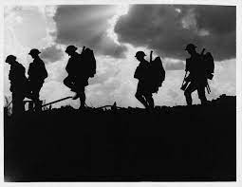
Selected chronology of plays about the First World War
1916 – Night Watches, Allan Monkhouse
1918 – My Eyes Have Seen, Alice Dunbar-Nelson
1924 – Tunnel Trench, Hubert Griffith
1928 – Journey’s End, RC Sherriff
1930 – Post-Mortem, Noel Coward
1963 – Oh, What A Lovely War!, Joan Littlewood
1981 – The Accrington Pals, Peter Whelan
2010 – Sea and Land and Sky, Abigail Docherty

Slide 47
WEEK 2: Y9 WAR WRITING
Key questions | Core knowledge | Terminology & vocabulary | Discussion, reading & writing
Big questions: How would it have felt to be a soldier living and fighting in WW1? Key questions: When is Journey’s End set? What rank are Osborne, Stanhope & Raleigh? What are the key moments in the play? | Key characters: Osborne, Stanhope & Raleigh. What do they each symbolise? The play takes place over 4 days. The constrained timespan, claustrophobic setting, and the feeling of inevitable doom help to create sense of unity. Events in the play do not fit neatly together nor do they lead naturally on to the next. The audience is left not knowing what to think. Rather what Sherriff does is include a number of complications (a twist which is introduced into a play to heighten tension and prolong the climax of the story), moments of drama and an exploration of characters’ reactions and relationships, showing the conditions of war. Just as in Alice’s Adventures in Wonderland (read by Osborne), where nothing makes sense, so this world seems to make no sense itself. Texts: RC Sheriff, Journey’s End Page numbers refer to the Heinemann Plays edition. ISBN: 978-0-435232-90-0. NB. This is a short play and can be read in less than 2 hours. Journey’s End context | Terminology act symbolism realism Aristotle’s unities Vocabulary heroism comrade regulations insubordination | Structured discussions: How do the opening stage directions prepare us for the play? Couch to 5 k writing: How are Stanhope and Raleigh used as symbolic characters? Write Osborne or Raleigh’s letter home before the raid Reading fluency: Parts of the text of Journey’s End should be read using echo/choral reading to enhance students’ understanding of performance & stagecraft
Expert knowledge The well-made play is a dramatic genre from 19th century theatre, developed by the French dramatist Eugène Scribe. It is characterised by concise plotting, compelling narrative and a largely standardised structure, with little emphasis on characterisation and intellectual ideas. The is some argument about whether Journey’s End fits this definition. Because of the play’s realism, some critics have accused it of having no structure: “the play is a series of scenes almost unrelated and as difficult to interpret as they would be in real life” (the Times 1929). The apparent disorganised nature of events is a reflection of the chaos of war where things do not follow strict patterns. Aristotle’s dramatic unities are the unity of action: a play should have one main action that it follows, with no or few subplots; the unity of place: a play should cover a single physical space and should not attempt to compress geography, nor should the stage represent more than one place; the unity of time: the action in a play should take place over no more than 24 hours. Robert Cedric Sherriff was born in 1896 in Hampton Wick, Middlesex. Upon finishing school in 1914, he began working in his father’s insurance office, working as a clerk until World War I. Sherriff served in the East Surrey Regiment, fighting in several notable battles until he was finally injured in 1917. At this point, he returned to his original line of work, acting as an insurance adjuster for ten years. During this period, he began to write plays, drawing upon his wartime experiences in works like Journey’s End, his most famous and celebrated artistic effort. First produced in 1928, Journey’s End attracted widespread critical acclaim and enjoyed a long run in London. After this success, Sherriff attended New College, Oxford in the early thirties, where he was part of the Royal Society of Literature and the Society of Antiquaries of London. During his lifetime, he composed eighteen original plays, wrote fifteen film scripts, and even published several novels.

Slide 48
Year 9 English
Michaelmas Term
War Writing
Week 2, Lesson 1

Slide 49
Recap:
Use the word ‘incompetent’ in a sentence.
What is a patriot?
Change courage to make it an adjective.
What type of word is ‘despite’?
Who is Wilfred Owen?

Slide 50
Terminology
act
symbolism
realism
Aristotle’s unities
Vocabulary
heroism
comrade
regulations
insubordination
Vocabulary Learning
Comrade
Rate how well you know it:
Never seen it before
Seen it, heard it, unsure what it means
Understand and can sometimes use
Confidently understand and can explain

Slide 51
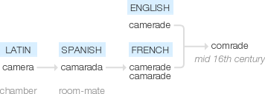
New Word:
Comrade
Spell It:
Say It!
Etymology:
mid 16th century (originally also camerade ): from French camerade, camarade (originally feminine), from Spanish camarada ‘room-mate’, from Latin camera ‘chamber’.
“Com-raid”
Com-rade
Understand it
Definition: a fellow soldier or member of the armed forces.
Word Class: Noun
Example: "Hewett turned and rushed to help his comrade"

Slide 52
Structured discussion
What is your impression of the description of the dug-out? What do you think it might be like to live there?
What does this suggest about the story to follow?
Does this seem like an accurate reflection of the realities of war?
Opening stage directions – setting of Saint Quentin.
Note the date: Evening on Monday, 18th March 1918.

Slide 53
Focussing on character and plot:
read (ideally perform) the act (p 1-31)

Slide 54
Focus on staging: all the action takes place in the officer’s dugout – we never see outside into the trench although we hear the sounds of war off stage. This makes the setting more claustrophobic and tense.

Slide 55
Check understanding:
Describe both Hardy and Osborne in three words.
What do Hardy and Osborne reveal about Stanhope? (5-6)
Why do you think Sherriff introduces the character of Raleigh?
What else do we learn about Stanhope from Raleigh? (11-12)
Why do we hear so much about Stanhope before his entrance on p 17?
How is Trotter different to the other officers?
What is Mason’s role in the play?

Slide 56
Year 9 English
Michaelmas Term
War Writing
Week 2, Lesson 2
Recap:
What rank is Stanhope?
What is Osborne’s nickname?
How does Raleigh know Stanhope?
What does the verb ‘glorify’ mean?
What is a thesis statement?

Slide 57
Terminology
act
symbolism
realism
Aristotle’s unities
Vocabulary
heroism
comrade
regulations
insubordination
Vocabulary Learning
Heroism
Rate how well you know it:
Never seen it before
Seen it, heard it, unsure what it means
Understand and can sometimes use
Confidently understand and can explain

Slide 58
New Word:
Heroism
Spell It:
Say It!
Etymology:
late 17th century: from French héroïsme, from héros, from Latin heros (see hero).
“Herro-ism”
He-ro-ism
Understand it
Definition: great bravery.
Word Class: Noun
Example: "they fought with exemplary heroism"

Slide 59
Read Act 2 scene 1 (pp.32-48)
Check understanding:
Why does Act 2 begin with a conversation between Trotter and Mason?
What are your thoughts about the character of Osborne? What is his role in the play?
Discuss vocab like ‘Boche’ (Germans) and phosgene (poison gas) whizz-bangs (an artillery shell) Wipers (Ypres)
What do you notice about the way most of the officers speak?
What’s causing the tension between Raleigh & Stanhope?
What do we learn in the incident of the letter? What is Stanhope afraid of?

Slide 60
Year 9 English
Michaelmas Term
War Writing
Week 2, Lesson 3
Recap:
Change heroism to make it an adjective
What does camaraderie mean?
Suggest three words to describe Stanhope
What does the verb ‘glorify’ mean?
What is a subordinate clause?

Slide 61
Terminology
act
symbolism
realism
Aristotle’s unities
Vocabulary
heroism
comrade
regulations
insubordination
Vocabulary Learning
Insubordination
Rate how well you know it:
Never seen it before
Seen it, heard it, unsure what it means
Understand and can sometimes use
Confidently understand and can explain

Slide 62
New Word:
Insubordination
Spell It:
Say It!
Etymology:
1790, on the model of French insubordination (1775); from in- (1) "not, opposite of" + subordination.
“In-sub-ord-inashon”
In-sub-ord-ination
Understand it
Definition: defiance of authority; refusal to obey orders.
Example: "he was dismissed for insubordination"
Word Class: Noun

Slide 63
Read Act 2 scene 2 (pp.33-65)
Check understanding:
Let’s discuss the purpose of non-commissioned officers and the sergeant major’s role in the army. We see the disparity between Stanhope’s and the SM’s ages.
Contrast with the Colonel – what is his purpose in visiting the trenches? How is life different at Head Quarters?
Why is Stanhope so angry with Hibbert? Note the language he uses ‘worm’, ‘swine’
Why does Stanhope change his attitude towards Hibbert?
What’s the significance of Osborne reading Alice’s Adventures in Wonderland?
How do Raleigh and Osborne feel about the raid?
How do you think Stanhope feels?

Slide 64
1. **Disparity between Stanhope, the SM, and the Colonel:**
- Stanhope is a young officer in the trenches, while the Sergeant-Major (SM) and the Colonel are older men. Stanhope represents the youth and vitality of the soldiers at the front, while the SM and Colonel symbolize the older generation and the military hierarchy.
- The Colonel's purpose in visiting the trenches is to inspect the front lines, maintain discipline, and gather information about the state of affairs. He represents the high command and the link between the soldiers on the front and the officers at headquarters.
- Life at headquarters is significantly different from the trenches. It's safer and more comfortable, with better food and amenities. Officers at headquarters are more removed from the immediate dangers of combat, which creates a contrast with the front-line experience.
2. **Stanhope's anger with Hibbert:**
- Stanhope is angry with Hibbert because he suspects that Hibbert is faking illness to avoid going on a dangerous raid. Stanhope believes that Hibbert is trying to shirk his duty, which he views as cowardly and unacceptable in the face of the war's brutality.
- The use of derogatory language like "worm" and "swine" reflects Stanhope's frustration and contempt for Hibbert's apparent cowardice.
3. **Stanhope changing his attitude towards Hibbert:**
- Stanhope's attitude towards Hibbert changes when he learns about Hibbert's neuralgia, a condition causing severe pain. Stanhope realizes that Hibbert's ailment is genuine and not just an excuse to avoid duty. This understanding leads Stanhope to show empathy and compassion towards Hibbert.
4. **Significance of Osborne reading Alice's Adventures in Wonderland:**
- Osborne reading "Alice's Adventures in Wonderland" symbolizes his desire to escape the harsh reality of war, even if only temporarily. The book serves as a form of escapism, offering a contrast to the grim and brutal world of the trenches. It highlights Osborne's sensitivity and his attempt to find solace in literature amid the chaos of war.
5. **Raleigh and Osborne's feelings about the raid:**
- Raleigh is initially excited and nervous about the raid. He sees it as an opportunity to prove himself in front of Stanhope and to gain acceptance among his fellow soldiers.
- Osborne, on the other hand, is more experienced and calm about the raid. He understands the risks and accepts them as part of their duty. He tries to reassure Raleigh and keep his spirits up.
6. **How Stanhope feels about the raid:**
- Stanhope likely feels a mix of emotions about the raid. On one hand, he is responsible for the men under his command, including Raleigh, and he may be worried about their safety. On the other hand, he understands the grim reality of war and the necessity of such actions. His primary concern is the well-being of his men, and he may be haunted by the constant fear of losing them in combat.

Slide 65
Year 9 English
Michaelmas Term
War Writing
Week 2, Lesson 3/4
Recap:
Change comrade to make it an adjective
What are Aristotle’s unities?
Suggest three words to describe Osborne
Where is the play set?
What is symbolism?

Slide 66
Terminology
act
symbolism
realism
Aristotle’s unities
Vocabulary
heroism
comrade
regulations
insubordination
Vocabulary Learning
Regulations
Rate how well you know it:
Never seen it before
Seen it, heard it, unsure what it means
Understand and can sometimes use
Confidently understand and can explain

Slide 67
New Word:
Regulations
Spell It:
Say It!
[REG] + [YUH] + [LAY] + [SHUHNS]
Regu-la-tions
Etymology:
early 15c., regulaten, "adjust by rule, method, or control," from Late Latin regulatus, past participle of regulare "to control by rule, direct," from Latin regula "rule, straight piece of wood"
Understand it
Definition: a rule or directive made and maintained by an authority.
Example: "planning regulations"
Word Class: Noun

Slide 68
Read Act 3 scene 1 (pp.66-103)
Check understanding:
(pp.66-80)
How do you think Stanhope feels towards the Colonel?
How do you think Osborne feels about being recommended for an M.C.? Compare to Raleigh.
How does Sherriff build tension? Why does Osborne keep changing the subject?
What do we learn about Osborne?
What’s the effect of the raid happening off stage?
Compare the Colonel’s treatment of the German prisoner with that of his own men.

Slide 69
Check understanding:
(pp.80-91)
Why doesn’t Raleigh join in the celebrations?
What are we supposed to think of Hibbert’s behaviour?
Why is Stanhope upset that Raleigh shares his rations with the men? Why does he call him a “bloody little swine”?
(pp.92-101)
Compare Mason and Hibbert’s feelings about ‘standing to’
Why does Stanhope remain in the dug-out?
Note Stanhope calls Raleigh ‘Jimmy’
What has changed? What do you think happens at the end?

Slide 70
Write Osborne or Raleigh’s letter home before the raid
Teacher to select 5 sentences (3 from 1-23 plus 24-5). SLOW writing practice.
E.g.

Slide 71
Extension: Additional Reading
Journey’s End: An Account of the Changing Responses Towards the First World War’s Representation
Amanda Phipps https://warwick.ac.uk/fac/arts/history/students/retrospectives/issues/amanda-phipps.pdf
The well-made play and the play made well, Maddy Costa
https://www.writeaplay.co.uk/the-well-made-play-and-the-play-made-well-by-maddy-costa/
Form, structure and language in Journey's End
https://www.bbc.co.uk/bitesize/guides/z8kky4j/revision/5
Journey’s end – the classic war play explored, Robert Gore-Langton
Book review by Dominic Cavendishhttps://www.theatrevoice.com/review/journeys-end-classic-war-play-explored-robert-gore-langton/

Slide 72
WEEK 3: Y9 WAR WRITING
Key questions | Core knowledge | Terminology & vocabulary | Discussion, reading & writing
Big questions: How do human beings cope with the horrors of war? Is it better to feel pain or numbness? Key questions: What is modernism? How is modernism a reaction to WW1? | Features of modernism: individualism (the individual is more important than society) experimentation (breaking free of old forms & techniques) absurdity (the violence of the war = madness) symbolism (reality has multiple layers) formalism (art is a process made of parts) Although Journey’s End seems stylistically conventional. Yet if we consider the play’s concerns — such as waiting and the absurdity of life, or at least life when viewed from the trenches — we can appreciate a certain modernist mode of thought. Which of the above features apply to the play? Texts: Ian Beck, Propping Up The Line Wilfred Owen, ‘Exposure’ Alcoholism and the First World War. | Terminology modernism symbolism absurdity individualism formalism Vocabulary brutality alcoholism neuralgia prohibit | Structured discussions: To what extent is Journey’s End a modernist play? Couch to 5 k writing: How do writers convey the horrors of war? Should Hibbert be sent on medical leave? (Persuasive writing) Compare how RC Sherriff and Wilfred Owen present the horrors of war. Reading fluency: Scenes from Journey’s End
Expert knowledge One biographer, Antony Cronin, terms Samuel Beckett (a man who was not only a Nobel laureate but also won the Croix de Guerre (cross of war) for his work with the French resistance during the Second World War) the last modernist. Consider the extent to which you believe Beckett and Sheriff might have shared some of the same concerns. The following article explores the popularity of Beckett’s seminal play, Waiting for Godot, whose sense of waiting and the futility of waiting we see in Journey’s End: http://www.bbc.co.uk/news/education-20889073 The following site promotes the 2015 production of Happy Days in which a woman is buried up to her waist in sand. There is also a range of related links: http://www.youngvic.org/whats-on/happy-days The following review from the New York Times is worth reading for its final paragraphs, which consider Sheriff as a precursor to Beckett: http://www.nytimes.com/2014/06/22/theater/r-c-sherriffs-journeys-end-a-remembrance-of-war.html

Slide 73
Year 9 English
Michaelmas Term
War Writing
Week 3, Lesson 1
Recap:
What year is Journey’s End set?
How does Stanhope ‘cope’ with the experience of war?
What is Hibbert’s strategy for coping with the war?
What does ‘insubordination’ mean?
What is ‘comradeship’?

Slide 74
Terminology
modernism
symbolism
absurdity
individualism
formalism
Vocabulary
brutality
alcoholism
neuralgia
prohibit
Vocabulary Learning
Brutality
Rate how well you know it:
Never seen it before
Seen it, heard it, unsure what it means
Understand and can sometimes use
Confidently understand and can explain

Slide 75
New Word:
Brutality
Spell It:
Say It!
Broot-al-itty
Bru-tal-ity
Etymology:
1540s, "quality of resembling a brute;" 1630s, "savage cruelty, inhuman behavior, insensibility to pity or shame," from brutal + -ity. The literal sense of "condition or state of a brute" is from 1711.
Understand it
Definition: savage physical violence; great cruelty.
Example:"brutality against civilians"
Word Class: Noun

Slide 76
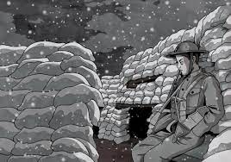
Read Ian Beck’s short story ‘Propping up the Line’ and Wilfred Owen’s poem ‘Exposure’ pp.22-23
Discuss the different ways these writers convey the horrors of war.

Slide 77
Comparing the ways writers convey the realities of war p.24
 | What is highlighted about life in the trenches? | What is the mood or tone of the text? | How is the writer creating this mood? (How?) | What is the intention of each writer? (why?)
Propping up the Line
Exposure
Journey’s End

Slide 78
Check understanding:
Choose two of the three texts.
Which conveys the reality of war most successfully?
Write a one sentence thesis statement:
‘Although [point about text 1], [point about text 2 which suggests it is more successful.]’

Slide 79
Year 9 English
Michaelmas Term
War Writing
Week 3, Lesson 2

Slide 80
Terminology
modernism
symbolism
absurdity
individualism
formalism
Vocabulary
brutality
alcoholism
neuralgia
prohibit
Vocabulary Learning
Alcoholism
Rate how well you know it:
Never seen it before
Seen it, heard it, unsure what it means
Understand and can sometimes use
Confidently understand and can explain

Slide 81
New Word:
Alcoholism
Spell It:
Say It!
Alco-hol-sim
Alco-hol-sim
Etymology:"disease of alcohol addiction," by 1882, from alcohol + -ism, or else from Modern Latin alcoholismus, coined in 1852 by Swedish professor of medicine Magnus Huss to mean what we now would call "alcohol poisoning, effects of excessive ingestion of alcohol."
Understand it
Definition: addiction to the consumption of alcoholic drink; alcohol dependency.
Example: "he had a long history of depression, drug abuse, and alcoholism“
Word Class: Noun

Slide 82
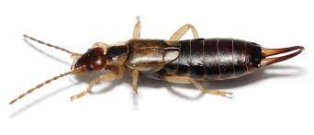
Task 1
Re-read p 8 where Hardy talks about earwig races
What do the earwigs symbolise? Explore the ways in which earwigs are similar to the soldiers
Task 3
Now compare how Hardy and Osborne view Stanhope’s drinking.
Write a one sentence thesis statement:
Despite Hardy’s view that [something negative about Stanhope], Osborne says [something positive about Stanhope].
Task 2
Now search for quotations on p 4-6 that show Hardy’s view that Stanhope is an alcoholic (locate and record a minimum of 5 quotations)

Slide 83
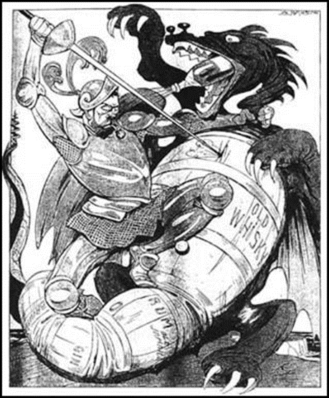
Year 9 English
Michaelmas Term
War Writing
Week 3, Lesson 3
Recap:
What did Ian Beck write about in ‘Propping up the Line’?
What does Wilfred Owen’s poem ‘Exposure’ describe?
What does ‘brutality’ mean?
What does ‘insubordination’ mean?
Describe one way in which Owen and Beck differ on their presentation of the reality of War.

Slide 84
Terminology
modernism
symbolism
absurdity
individualism
formalism
Vocabulary
brutality
alcoholism
neuralgia
prohibit
Vocabulary Learning
Prohibit
Rate how well you know it:
Never seen it before
Seen it, heard it, unsure what it means
Understand and can sometimes use
Confidently understand and can explain

Slide 85
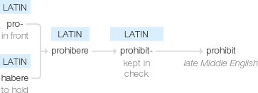
New Word:
Prohibit
Spell It:
Say It!
Etymology:
late Middle English: from Latin prohibit- ‘kept in check’, from the verb prohibere, from pro- ‘in front’ + habere ‘to hold’.
“Pro-hib-it”
Pro-hib-it
Understand it
Definition: formally forbid (something) by law, rule, or other authority.
Word Class: Verb
Example: "all ivory trafficking between nations is prohibited"

Slide 86
Alcohol and the First World War p.25-6
Questions
Why was the government concerned about the consumption of alcohol and what measure did they take to solve the problem?
Look closely at the image. What is in picture? What messages are these propaganda images sending?
Look again at the paragraph about controlling women’s drinking (line 21-26.) What does The Times newspaper imply about women’s proper roles and responsibilities?
What measure did the government introduce to control alcoholism?
Were these attempts to prevent alcoholism successful?

Slide 87
Task: Sentence expanding
The government was concerned about the effects of alcoholism because [provide a reason]
The government was concerned about the effects of alcoholism but [suggest something that shows they were successful in controlling it]
The government attempted to control the sale of alcohol so [what did they decide to do?]

Slide 88
Year 9 English
Michaelmas Term
War Writing
Week 3, Lesson 4
Recap:
Recall as much information as you can about Hibbert and ‘cowardice’

Slide 89
Terminology
modernism
symbolism
absurdity
individualism
formalism
Vocabulary
brutality
alcoholism
neuralgia
prohibit
Vocabulary Learning
Neuralgia
Rate how well you know it:
Never seen it before
Seen it, heard it, unsure what it means
Understand and can sometimes use
Confidently understand and can explain

Slide 90
New Word:
Neuralgia
Spell It:
Say It!
Etymology:
Greek neuron, "nerve" + algos, "pain"
“New-ral-ja”
Neu-ral-gia
Understand it
Definition: intense, typically intermittent pain along the course of a nerve, especially in the head or face.
Word Class: Noun
Example: "he suffered from facial neuralgia"

Slide 91
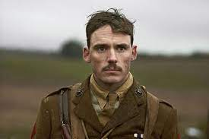
Let’s re-read p. 54- 58, focussing on Hibbert’s attempts to ‘cope’ with the war.
How does Sherriff present Hibbert?
Is he sympathetic?
Do modern understandings of PTSD help us feel more understanding?
Is he a coward?
Find evidence that Hibbert’s attempts to cope are unsuccessful
Write a 2 sentence answer to this question:
What does the characterisation of Hibbert tell us about the reality of war?
Sentence 1 = thesis statement: Despite [how Hibbert tries to cope], [what the results of his behaviour?]
Sentence 2: “This is shown when he says “ ___________.”

Slide 92
Task: Sentence combining
Soldiers in WW1 tried to cope with the horrors of war through drinking alcohol.
Some soldiers were clearly suffering from post-traumatic stress.
One way to cope with war was to feign illness in order to be sent home.

Slide 93
Should Hibbert be sent on medical leave?
(Persuasive writing)

Slide 94
Extension: Additional Reading
The horror and futility of war in Journey's End
BBC Bitesize:
https://www.bbc.co.uk/bitesize/guides/znpx382/revision/2
Courage and cowardice in Journey's End
BBC Bitesize:
https://www.bbc.co.uk/bitesize/guides/znpx382/revision/3
The Main Characteristics of Modernist Literature, Josh Patrick
https://penandthepad.com/main-characteristics-modernist-literature-8451197.html

Slide 95
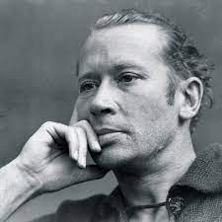
La Guerre (I) by E. E. Cummings
Humanity i love you because you would rather black the boots of success than enquire whose soul dangles from his watch-chain which would be embarrassing for both
parties and because you unflinchingly applaud all songs containing the words country home and mother when sung at the old howard
Humanity i love you because when you're hard up you pawn your intelligence to buy a drink and when you're flush pride keeps
you from the pawn shop and because you are continually committing nuisances but more especially in your own house
Humanity i love you because you are perpetually putting the secret of life in your pants and forgetting it's there and sitting down
on it and because you are forever making poems in the lap of death Humanity
i hate you
“Earwigs in Whiskey”, Mark Payton
The English Review p.71 of the Teacher’s Guide
Staging the war, Luke McBratney p.74 of the Teacher’s Guide

