Slide 1
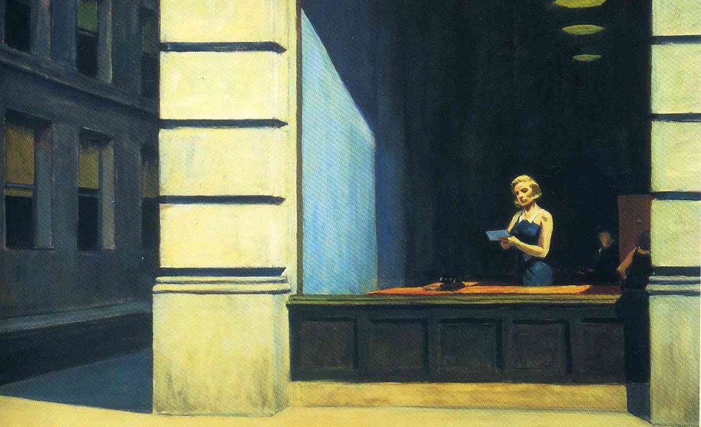
American Literary Movements

Slide 2
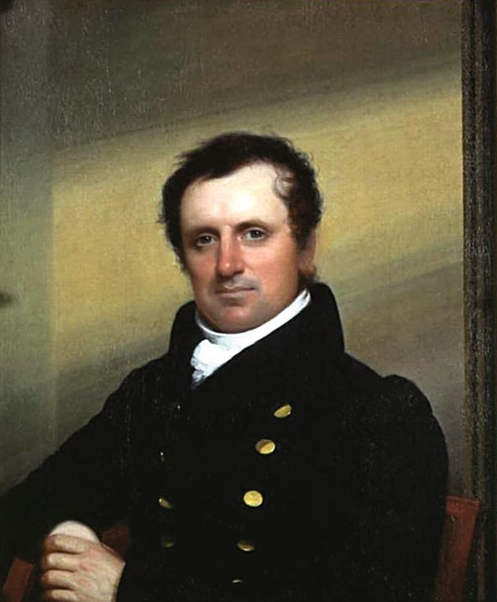
A Reminder!
Frontier Literature (1800-1880)
In 1800, the United States occupied about one-third of its present territory. Over the
course of the century, its boundaries expanded westward through the purchase of territory
from France, the forced migration of indigenous people, and war with Mexico. Newly
“freed” territory was made available to migrants from further east and abroad for
settlement, until the 1890 census declared that America’s western frontier, or line
demarcating America’s unsettled territory, was broken up, its period of expansion over.
In the process of expansion, indigenous people were displaced further westward, then
removed to reservations and sent to boarding schools where they were supposed to be
“assimilated,” thousands of Mexicans suddenly found themselves aliens in their former homes, and millions of people from further east and abroad migrated westward. James Fennimore Cooper, Washington Irving, Cooper (Mark Twain born 1835)

Slide 3
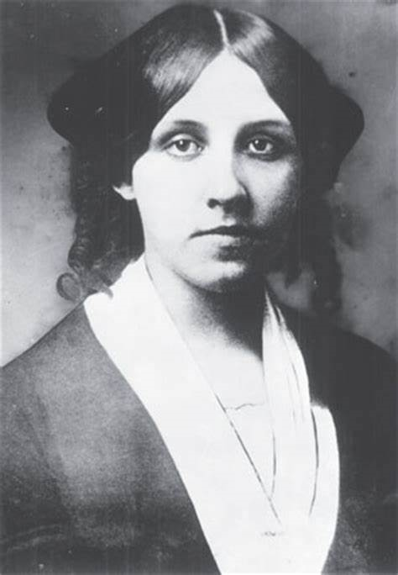
Realism, Naturalism & Regionalism (1865-1914)
As America suffered from growing pains, this movement was marked by feelings of disillusionment. Familiar subjects included ghettos of rapidly growing cities, the Industrial Revolution, and corrupt politicians. Authors focused on painting a realistic setting of everyday life and ordinary people, including local colour, while also seeking to explain human behaviour. ​Louisa May Alcott (Little Women), Mark Twain (Huckleberry Finn 1884), Henry James, Emily Dickinson, Jack London (The Call of the Wild, White Fang), Edith Wharton

Slide 4
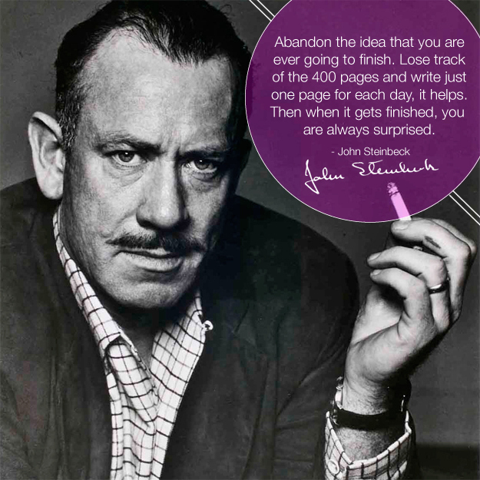
Modernism 1914 - 1945
Modernism began as an extension of realism, but made efforts to break with literary and poetic traditions. Authors of this era were bold and experimental in style; an example of this being the “stream of consciousness”. Commonly dealing with the struggles of individuals, modernist literature can seem bleak, but is characterized by the optimistic belief that people can change the world around them. T.S. Eliot, Theodore Dreiser, Robert Frost, Ezra Pound, William Faulkner

Slide 5
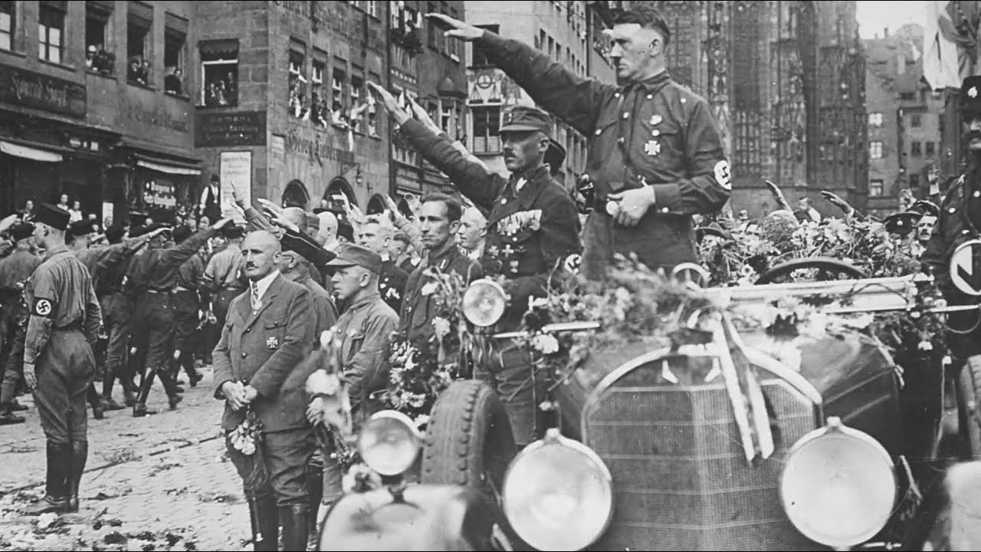
Anyone who looks at the evolution of Western culture must note a distinct change in thought, behaviour, and cultural production beginning sometime in the late nineteenth century and coming to full fruition sometime around the Second World War. This change, whether art, technology, philosophy or human behaviour, is generally called Modernism.
Modernism designates the broad literary and cultural movement that spanned all of the arts and even spilled into politics and philosophy. Like Romanticism, Modernism was highly varied in its manifestations between the arts and even within each art.

Slide 6
Modernism’s roots are in the rapidly changing technology of the late nineteenth century and in the theories of such late nineteenth-century thinkers as Freud, Marx, Darwin, and Nietzsche. Modernism influenced painting first (Impressionism and Cubism are forms of Modernism), but in the decade before World War I such writers as Ezra Pound, Filippo Marinetti, James Joyce, and Guillaume Apollinaire translated the advances of the visual arts into literature. Such characteristically modernist techniques as stream-of-consciousness narration and allusiveness, by the late 1930s, spilled into popular writing and
became standard.

Slide 7
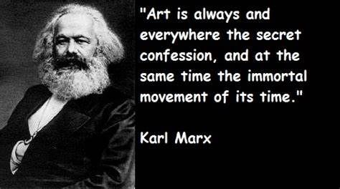
The movement’s concerns were with the accelerating pace of society toward destruction and meaninglessness. In the late 1800s many of society’s certainties were undermined. Marx demonstrated that social class was created, not inherent; Freud boiled down human individuality to an animalistic sex drive; Darwin provided evidence that the Bible might not be literally true; and Nietzsche argued that even the most deeply-held ethical principles were simply constructions. Modernist writers attempted to come to terms with where humanity stood after its cornerstones had been pulverized. The movement sifted through the shards of the past looking for what was valuable and what could inspire construction of a new society.

Slide 8
In contrast to the Romantic world view, the Modernist cares rather little for Nature, Being, or the overarching structures of history. Instead of progress and growth, the Modernist intelligentsia sees decay and a growing alienation of the individual. The machinery of modern society is perceived as impersonal, capitalist, and antagonistic to the artistic impulse. War most certainly had a great deal of influence on such ways of approaching the world. Two World Wars in the span of a generation effectively shell-shocked all of Western civilization.
The nineteenth century, like the several centuries before it, was a time of privilege for wealthy Caucasian males. Women, minorities, and the poor were marginalized to the point of utter silence and inconsequence. The twentieth century witnessed the beginnings of a new paradigm between first the sexes, and later between different cultural groups.

Slide 9
Leading up to the First World War, Imagist poetry was dominating the scene, and sweeping previous aesthetic points of view under the rug. The Imagists, among them Ezra Pound, sought to boil language down to its absolute essence. They wanted poetry to concentrate entirely upon “the thing itself,” in the words of critic-poet T. E. Hulme. To achieve that effect required minimalist language, a lessening of structural rules and a kind of directness that Victorian and Romantic poetry seriously lacked. Dreaminess or Pastoral poetry were utterly abandoned in favour of this new, cold, some might say mechanized poetics. Imagist poetry was almost always short, unrhymed, and noticeably sparse in terms of adjectives and adverbs. At some points, the line between poetry and natural language became blurred. This was a sharp departure from the ornamental, verbose style of the Victorian era. Gone also were the preoccupations with beauty and nature. Potential subjects for poetry were now limitless, and poets took full advantage of this new freedom.

Slide 10
Influenced by the first World War, many American modernist writers explored the psychological wounds and spiritual scars of the war experience. The economic crisis in America at the beginning of the 1930s also left a mark on literature, such as John Steinbeck’s The Grapes of Wrath. A related issue is the loss of self and need for self-definition, as workers faded into the background of city life, unnoticed cogs within a machine yearning for self-definition. American modernists echoed the mid-19th-century focus on the attempt to "build a self"—a theme illustrated by Fitzgerald's The Great Gatsby. Madness and its manifestations seems to be another favourite modernist theme, as seen in Eugene O ’Neill’s The Emperor Jones, Hemingway's
The Battler and Faulkner's That Evening Sun.
Nevertheless, all these negative aspects led to new hopes and
aspirations, and to the search for a new beginning, not only for the
Contemporary individuals, but also for the fictional characters in
American modernist literature.

Slide 11
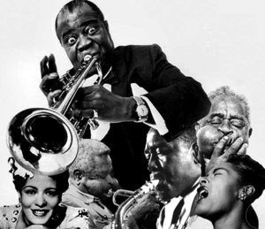
The Harlem Renaissance
Modernist literature also allowed for the development of regional trends within American literature, including the Harlem Renaissance and southern modernism. The Harlem Renaissance marked a rebirth for African American arts, centralized in the Harlem area of New York. Writers and thinkers such as Alain Locke, Claude McKay, Langston Hughes and Zora Neale Hurston were among the key figures of the movement. The movement was connected to a vogue for African American culture, as seen too in the popularity of Jazz music, with many writers financed by white patrons. Many writers of this movement used modernist techniques to represent African American life, for instance incorporating the rhythms of Jazz music and dialects of African American culture into poetry and prose. Southern modernism similarly represented the life and unique experiences of the South using modernist aesthetics, with celebrated figures including William Faulkner and Tennessee Williams.

Slide 12
The Lost Generation
In American Literature, the group of writers and thinkers known as the Lost Generation has become synonymous with Modernism. In the wake of the First World War, several American artists chose to live abroad as they pursued their creative impulses. These included the intellectual Gertrude Stein, the novelists Ernest Hemingway and F. Scott Fitzgerald, and the painter Waldo Pierce, among others. The term itself refers to the spiritual and existential hangover left by four years of unimaginably destructive warfare. The artists of the Lost Generation struggled to find some meaning in the world in the wake of chaos. As with much of Modernist literature, this was achieved by turning the mind’s eye inward and attempting to record the workings of consciousness. For Hemingway, this meant the abandonment of all ornamental language. His novels are famous for their extremely spare, blunt, simple sentences and emotions that play out right on the surface of things. There is an irony to this bluntness, however, as his characters often have hidden agendas, hidden sometimes even from themselves, which serve to guide their actions. The Lost Generation, like other “High Modernists,” gave up on the idea that anything was truly knowable. All truth became relative, conditional, and in flux. The War demonstrated that no guiding spirit rules the events of the world, and that absolute destruction was kept in check by only the tiniest of margins.
The novel was by no means immune from the self-conscious, reflective impulses of the new century. Modernism introduced a new kind of narration to the novel, one that would fundamentally change the entire essence of novel writing. The “unreliable” narrator supplanted the omniscient, trustworthy narrator of preceding centuries, and readers were forced to question even the most basic assumptions about how the novel should operate. James Joyce’s Ulysses is the prime example of a novel whose events are really the happenings of the mind, the goal of which is to translate as well as possible the strange pathways of human consciousness. A whole new perspective came into being known as “stream of consciousness.” Rather than looking out into the world, the great novelists of the early twentieth century surveyed the inner space of the human mind. At the same time, the psychoanalytic theories of Sigmund Freud had come into mainstream acceptance. These two forces worked together to alter people’s basic understanding of what constituted truth and reality.

Slide 13
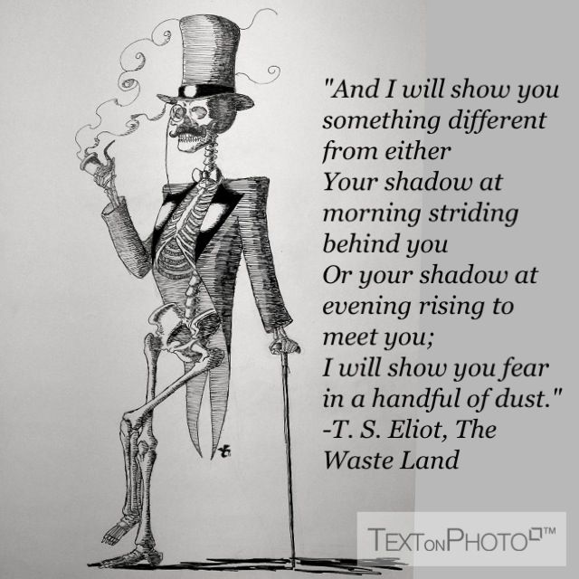
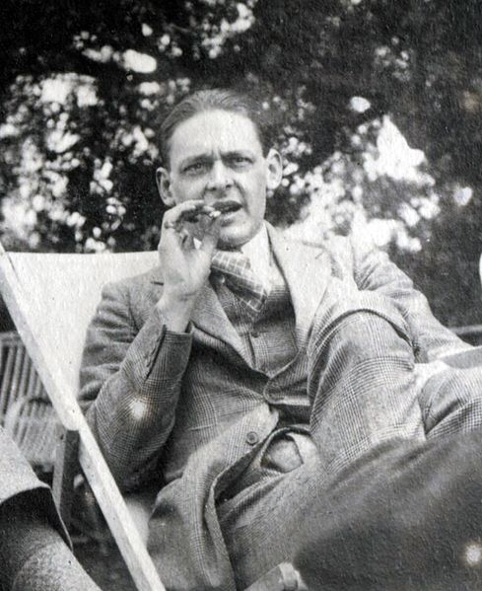
Experimentation with genre and form was yet another defining characteristic of Modernist literature. Perhaps the most representative example of this experimental mode is T. S. Eliot’s long poem The Waste Land. Literary critics often single out The Waste Land as the definitive sample of Modernist literature. In it, one is confronted by biblical-sounding verse forms, quasi-conversational interludes, dense and frequent references which frustrate even the most well-read readers, and sections that resemble prose more than poetry. At the same time, Eliot fully displays all the conventions which one expects in Modernist literature. There is the occupation with self and inwardness, the loss of traditional structures to buttress the ego against shocking realities, and a fluid nature to truth and knowledge.

Slide 14
T.S. Eliot
Thomas Stearns Eliot was born in St. Louis, Missouri, on September 26, 1888. He attended Harvard, the Sorbonne and Oxford, studying philosophy and writing a dissertation on the logician F. H. Bradley. While in college, Eliot began writing poetry, but in 1908 he discovered French Symbolist poetry and his whole attitude toward literature changed. Ezra Pound read some of Eliot’s poetry in the 1910s and immediately decided that Eliot would be a member of his own literary circle. Pound advocated for Eliot with Harriet Monroe of Poetry magazine and got Eliot’s poem “The Love Song of J. Alfred Prufrock” published in that journal in 1915. Eliot had settled in London at the same time, and married the emotionally unstable Vivian Haigh-Wood. Eliot struggled to make a living, working as a teacher and later at Lloyd’s Bank until 1925.
In 1922 Eliot broke through with his brilliant and successful poem “The Waste Land, ” although the manuscript of the poem demonstrates that Ezra Pound played a large role in the editing of the poem. “The Waste Land” brought Eliot fame and a place at the centre of the burgeoning modernist movement. For the rest of the 1920s and 1930s, Eliot used his fame and his position as editor of a prominent literary journal (The Criterion) and as managing editor of the publishing house Faber & Faber to argue for a new standard of evaluating literature. In critical essays and his own poetry, he denigrated the romantics and neoclassicists and celebrated Dante and the Elizabethan “metaphysical” poets. He argued for the central role of “Tradition” in literature and downplayed the cult of individual genius created by the romantics.
For the remainder of his life, Eliot occupied the role of literary elder statesman. He continued to produce poems such as the Four Quartets but was never prolific. He became the very model of the conservative, royalist, High Church English gentleman. He died January 4, 1965, the very embodiment of the literary establishment.

Slide 15
William Faulkner
William Faulkner was born in New Albany, Mississippi, on September 25, 1897, to a family with deep Mississippi and Confederate roots. He grew up in Oxford, Mississippi, and briefly attended the University of Mississippi before leaving the state to seek his fortune as a writer. Settling briefly in New Orleans, Faulkner came under the tutelage of Sherwood Anderson and published his first book, The Marble Faun, a collection of short stories, in 1924. In 1929 he published the novel Sartoris, his first work set in the fictional Mississippi county of Yoknapatawpha. Others followed, including his masterpieces The Sound and the Fury and As I Lay Dying.
In the 1930s and 1940s, Faulkner received a great deal of critical attention for his works, but he never obtained the kind of financial success that he sought. Attempting to remedy this, he wrote two sensationalistic books (Sanctuary and Requiem for a Nun) and briefly moved to Los Angeles to work as a screenwriter in Hollywood. Faulkner died on July 6, 1962, in Byhalia, Mississippi.

Slide 16
Ezra Pound
In many ways, Ezra Pound was the father of literary Modernism. If nothing else, he almost single-handedly brought the techniques of Modernism to American poets, while at the same time bringing the talents of American modernist poets to the notice of the avant-garde establishment. Pound was born in Hailey, Idaho, on October 30, 1885, but soon after his birth his family moved to the suburbs of Philadelphia. He grew up in that area and attended the University of Pennsylvania (where he met William Carlos Williams and another important American modernist poet, Hilda Doolittle) and Hamilton College. After a short stint teaching at a small college in Indiana, Pound grew tired of what he saw to be American small-mindedness and moved to Venice, Italy.
In Venice, Pound resolved to become a poet. He published a book there, but soon relocated to London. In the decade he spent in London, Pound, through the strength of his own will, created movements and forced himself into the centre of those movements. Probably the most important of those movements was Imagism, a school of poetry that explicitly rejected Victorian models of verse by simply presenting images without authorial commentary. In 1920 Pound left London for Paris, where he spent a few years before becoming frustrated by the dominance of Gertrude Stein in the avant-garde scene there. In 1925 he moved to Rapallo, Italy, where he developed a strong affinity for Mussolini and Italian fascism. At this time he also began working in earnest on The Cantos, the epic poem that would become his life’s work.
Pound stayed in Italy for more than twenty years. During World War II he spoke on Italian state radio broadcasts aimed at American soldiers; in 1943 he was indicted for treason as a result of these activities and in 1945, returned to the United States to face trial. Found mentally unfit to defend himself, Pound was incarcerated in St. Elizabeth’s Hospital for the Criminally Insane in Washington, D.C. for thirteen years. Because of the intercession of such luminaries as T. S. Eliot, Robert Frost, and Ernest Hemingway, in 1958 Pound was released from his incarceration and allowed to return to Italy. Settling in Venice, he published a few more books but by the mid-1960s he fell into a silence. He died in Venice, Italy, on November 1, 1972.

Slide 17
John Steinbeck
Although certain elements of John Steinbeck's writing fit characteristics of a variety of literary movements, he will, without doubt, go down in history as a great modernist.
One of Steinbeck's most successful and influential and perhaps most relevant in terms of the modernism literary movement, novels was The Grapes of Wrath. The main point made in the story, of man under the conditions of the conditions of the Great Depression, is that no matter how intense the attack on its "existence" may be "the group will defend itself unyieldingly" (Gray 54). Because of the "social injustices" that were depicted so sharply in this book, Steinbeck himself was accused of being a revolutionary.
The "wrath" experienced by common man grows throughout the book, but is considered to be better than despair because "wrath" puts things into action, this is, without doubt, an attempt by Steinbeck to investigate the human consciousness through his writing.
Furthermore, this unified human experience which protagonists undergo throughout a multitude of Steinbeck's novels, is a defining trademark of early 20th century modernists such as Steinbeck. "It is a point in which is basic to Steinbeck's art. For to Steinbeck, modern life itself is often the enemy, in which characters find themselves lost in a world they never made and want nothing to do with" (Magill American 1889). Through such a style, Steinbeck's writing revolts against the conservative principles of realism, thus further securing his place in history as a modernist.

Slide 18
Main Themes and Devices
Modernism emphasized subjective perception rather than objective truth. Modernists didn't deny the existence of objective truth, but they believed that an overemphasis on objective truth ignored the vast, hitherto unexplored depths of human subjectivity. Modernist authors such as Virginia Woolf and James Joyce used the literary technique known as stream-of-consciousness to elucidate the inner workings of the mind in its engagements with the external world.
Modernism focused on individualism. For the most part, modernists saw themselves as individualists, pitting themselves against a society in decline. As many of the old values no longer commanded respect, modernists looked to themselves as individuals to create their own values, both in terms of the art they produced and also the moral values by which they lived their lives.
In Modernist literature, the individual is more interesting than society. Specifically, modernist writers were fascinated with how the individual adapted to the changing world. In some cases, the individual triumphed over obstacles. For the most part, Modernist literature featured characters who just kept their heads above water. Writers presented the world or society as a challenge to the integrity of their characters. Ernest Hemingway is especially remembered for vivid characters who accepted their circumstances at face value and persevered.

Slide 19
Modernism was interested in alienation, loss, and despair. To a large extent, modernism arose out of the alienation caused by the First World War. The so-called lost generation of artists felt particularly alienated from the society around them. Many of them succumbed to despair, feeling that society was so broken that there was no possible hope of redemption. Much modernist work is characterized by a pervading sense of nihilism—that there are no absolute values and that meaning itself is difficult to discern.
Experimentation Modernist writers broke free of old forms and techniques. Poets abandoned traditional rhyme schemes and wrote in free verse. Novelists defied all expectations. Writers mixed images from the past with modern languages and themes, creating a collage of styles. The inner workings of consciousness were a common subject for modernists. This preoccupation led to a form of narration called stream of consciousness, where the point of view of the novel meanders in a pattern resembling human thought. Authors James Joyce and Virginia Woolf, along with poets T.S. Eliot and Ezra Pound, are well known for their experimental Modernist works. Endings are often ambiguous and open-ended thus more reflective of reality.

Slide 20
Absurdity The carnage of two World Wars profoundly affected writers of the period. Several great English poets died or were wounded in WWI. At the same time, global capitalism was reorganizing society at every level. For many writers, the world was becoming a more absurd place every day. The mysteriousness of life was being lost in the rush of daily life. The senseless violence of WWII was yet more evidence that humanity had lost its way. Modernist authors depicted this absurdity in their works. Franz Kafka's "The Metamorphosis," in which a traveling salesman is transformed into an insect-like creature, is an example of modern absurdism.
Symbolism The Modernist writers infused objects, people, places and events with significant meanings. They imagined a reality with multiple layers, many of them hidden or in a sort of code. The idea of a poem as a riddle to be cracked had its beginnings in the Modernist period. Symbolism was not a new concept in literature, but the Modernists' particular use of symbols was an innovation. They left much more to the reader's imagination than earlier writers, leading to open-ended narratives with multiple interpretations. For example, James Joyce's "Ulysses" incorporates distinctive, open-ended symbols in each chapter.

Slide 21
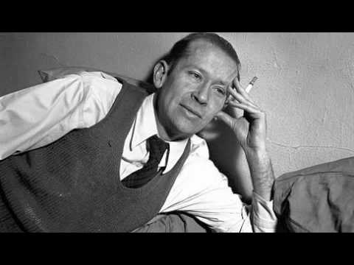
Formalism Writers of the Modernist period saw literature more as a craft than a flowering of creativity. They believed that poems and novels were constructed from smaller parts instead of the organic, internal process that earlier generations had described. The idea of literature as craft fed the Modernists' desire for creativity and originality. Modernist poetry often includes foreign languages, dense vocabulary and invented words. The poet e.e. cummings abandoned all structure and spread his words all across the page.

Slide 22
Stream of Consciousness
In literature, stream of consciousness is a method of narration that describes happenings in the flow of thoughts in the minds of the characters.
Another appropriate term for this device is “interior monologue,” where the individual thought processes of a character, associated to his or her actions, are portrayed in the form of a monologue that addresses the character itself. Therefore, it is different from the “dramatic monologue” or “soliloquy,” where the speaker addresses the audience or the third person.
The stream of consciousness style of writing is marked by the sudden rise of thoughts and lack of punctuation.

