Slide 1
In this lesson, students will be mastering the following:
Mastery Content:
Jane advertises for a job outside of Lowood School
She receives a job offer from Thornfield Hall to be a governess
Bessie visits Jane and recounts what has happened to the Reed family;
Georgiana and Eliza are pretty, but silly
John Reed is irresponsible
Mrs Reed is anxious because John is frittering away the family money
Jane is now a young woman. The events of her childhood have formed her character as an adult
Learning Objective:
To explore how and why Jane has changed since the beginning of the novel.
Mastery Content

Slide 2
Do Now: Mr Brocklehurst is still in charge at Lowood. True or False? List two changes that have happened to Miss Temple. Who was Jane’s first friend at Lowood School? What does the word ‘comeuppance’ mean? Extension: List all of the characters that treat Jane badly.
Recap Recap the events that we have skipped in reading. Jane advertised for a job outside Lowood School via the Post Office. One week later, she received a job offer from Thornfield Hall to be a governess. A governess is a live-in teacher in wealthy households.
Reading Read Bessie’s re-introduction and discussion of the Reed family. Read from, ‘“Miss,” said a servant…’ (page 107) Read to, ‘“… before you were quite out of my reach.”’ (page 108) The check for understanding questions explore what has happened to the Reeds over the past eight years.
Reading Read Bessie and Jane’s discussion about Jane and her accomplishments. Read from, ‘“I am afraid you are disappointed in me…”’ (page 108) Read to, ‘a new life in the unknown environs of Millcote.’ (page 110)
A young woman Jane has left childhood; she is now a young woman. Students need to describe what Jane was like as a child and what Jane is like as a young woman. Students can use evidence from the passage just read, or from the rest of chapter 10, or from earlier in the novel to explain what Jane is now like.
Jane’s changes Students answer this question independently in paragraphs: How has Jane changed across the novel so far?
Final thoughts That is the last reading for ‘Jane Eyre’! There are some questions here to invite students to reflect on what they have read.
Lesson Guide

Slide 3
Tuesday, 14 June 2022
Jane’s changes
Do Now:
Mr Brocklehurst is still in charge at Lowood. False, he is now just the treasurer.
Miss Temple married a clergyman and left Lowood school.
Helen Burns was Jane’s first friend at Lowood School.
In lots of stories, villains get their comeuppance. This means they receive some form of punishment for what they did.
Do Now:
Mr Brocklehurst is still in charge at Lowood. True or False?
List two changes that have happened to Miss Temple.
Who was Jane’s first friend at Lowood School?
What does the word ‘comeuppance’ mean?
Do Now
Extension: The characters that treat Jane badly are: Mrs Reed, John Reed, Miss Abbot and Mr Brocklehurst.
Extension: List all of the characters that treat Jane badly.

Slide 4
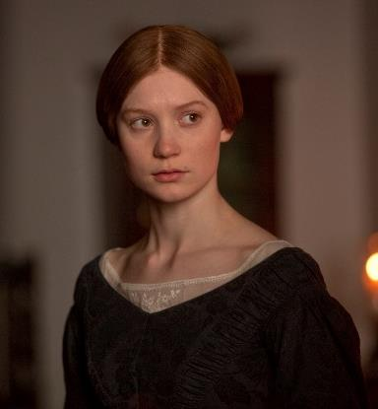
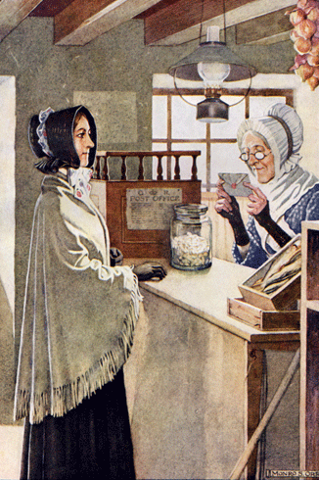
Much has changed since we last read ‘Jane Eyre’. Here are some important events that we have skipped.
Jane advertised for a job outside Lowood School via the Post Office.
One week later, she received a job offer from Thornfield Hall to be a governess.
A governess is a live-in teacher in wealthy households.
Jane Eyre
Jane Eyre

Slide 5
Today, we are going to finish reading the first section of ‘Jane Eyre’.
We will find out what has happened to Jane’s family from Gateshead Hall.
Jane Eyre
Let’s read.
Read from, ‘“Miss,” said a servant…’ (page 107)
Read to, ‘“… before you were quite out of my reach.”’ (page 108)
Jane

Slide 6
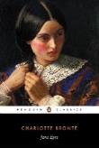
‘Miss,’ said a servant who met me in the lobby, where I was wandering like a troubled spirit, ‘a person below wishes to see you.’
‘The carrier, no doubt,’ I thought, and ran downstairs without inquiry. I was passing the back-parlour, or teachers’ sitting-room, the door of which was half open, to go to the kitchen, when someone ran out –
‘It’s her, I am sure! – I could have told her anywhere!’ cried the individual who stopped my progress and took my hand.
I looked: I saw a woman attired like a well-dressed servant, matronly, yet still young; very good-looking, with black hair and eyes, and lively complexion.
‘Well, who is it?’ she asked, in a voice and with a smile half recognised; ‘you’ve not quite forgotten me, I think, Miss Jane?’
In another second I was embracing and kissing her rapturously: ‘Bessie! Bessie! Bessie!’ that was all I said; whereat she half laughed, half cried, and we both went into the parlour. By the fire stood a little fellow of three years old, in plaid frock and trousers.
‘That is my little boy,’ said Bessie directly.
carrier – coach driver
attired – dressed
matronly – mature
rapturously – joyfully
Jane Eyre
p.107

Slide 7
‘Then you are married, Bessie?’
‘Yes: nearly five years since, to Robert Leaven, the coachman; and I’ve a little girl besides Bobby here, that I’ve christened Jane.’
‘And you don’t live at Gateshead?’
‘I live at the lodge: the old porter has left.’
‘Well, and how do they all get on? Tell me everything about them, Bessie: but sit down first, and, Bobby, come and sit on my knee, will you?’ but Bobby preferred sidling over to his mother.
‘You’re not grown so very tall, Miss Jane, nor so very stout,’ continued Mrs Leaven. ‘I daresay they’ve not kept you too well at school: Miss Reed is the head and shoulders taller than you are; and Miss Georgiana would make two of you in breadth.’
‘Georgiana is handsome, I suppose, Bessie?’
‘Very. She went up to London last winter with her mamma, and there everybody admired her, and a young lord fell in love with her: but his relations were against the match; and – what do you think? – he and Miss Georgiana made it up to run away: but they were found out and stopped.
sidling – creeping
stout – fat
Miss Reed – i.e. Eliza
relations – family
Jane Eyre
p.107-8

Slide 8
It was Miss Reed that found them out; I believe she was envious; and now she and her sister lead a cat-and-dog life together; they are always quarrelling.’
‘Well, and what of John Reed?’
‘Oh, he is not doing so well as his mamma could wish. He went to college, and he got – plucked, I think they call it. And then his uncles wanted him to be a barrister, and study law: but he is such a dissipated young man, they will never make much of him, I think.’
‘What does he look like?’
‘He is very tall. Some people call him a fine-looking young man; but he has such thick lips.’
‘And Mrs Reed?’
‘Missis looks stout and well enough in the face, but I think she’s not quite easy in her mind. Mr John’s conduct does not please her – he spends a deal of money.’
‘Did she send you here, Bessie?’
‘No, indeed; but I have long wanted to see you, and when I heard that there had been a letter from you, and that you were going to another part of the country, I thought I’d just set off, and get a look at you before you were quite out of my reach.’
envious – jealous
quarrelling – fighting
plucked – failed
dissipated – troublemaker
Jane Eyre
p.108

Slide 9
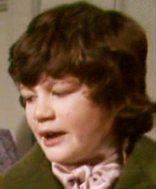
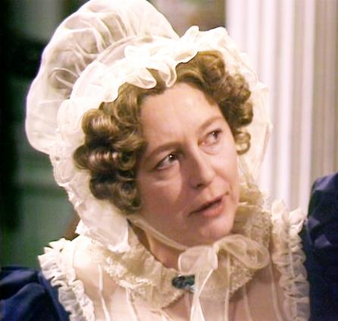
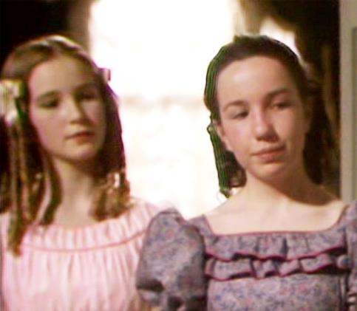
Discuss the answers to these questions in pairs:
Who comes to visit Jane?
Who else is named ‘Jane’?
Georgiana was almost married to a lord. Why did the wedding not take place?
How is John Reed?
The Reeds are much more wealthy than Jane. Are they happier for having their money? Are they better people than Jane?
Jane Eyre

Slide 10
Discuss the answers to these questions in pairs:
Bessie has come to visit Jane Eyre.
Bessie has two children. She named her daughter ‘Jane’.
The lord’s family didn’t want Georgiana to marry their son. He and Georgiana were going to run away and get married in secret, but they were found out. Bessie says that Eliza stopped them from running away because she was jealous of her sister.
John Reed failed all his university exams and dropped out. John’s uncle doesn’t think that he will be able to become a barrister because he is too reckless and irresponsible. John is spending a lot of the family’s money.
What were your thoughts on this question?
Jane Eyre

Slide 11
After telling Jane about the Reed family, Bessie asks about Jane.
Through Bessie’s eyes, we can see how much Jane has changed over the past eight years.
For the final time… Let’s read!
Read from, ‘“I am afraid you are disappointed in me…”’ (page 108)
Read to, ‘a new life in the unknown environs of Millcote.’ (page 110)
Jane Eyre
Jane

Slide 12
‘I am afraid you are disappointed in me, Bessie?’ I said this laughing. I perceived that Bessie’s glance, though it expressed regard, did in no shape denote admiration.
‘No, Miss Jane, not exactly. You are genteel enough; you look like a lady, and it is as much as I ever expected of you: you were no beauty as a child.’
I smiled at Bessie’s frank answer; I felt that it was correct, but I confess I was not quite indifferent to its import. At eighteen most people wish to please, and the conviction that they have not an exterior likely to second that desire brings anything but gratification.
‘I daresay you are clever, though,’ continued Bessie, by way of solace. ‘What can you do? Can you play on the piano?’
‘A little.’
There was one in the room; Bessie went and opened it, and then asked me to sit down and to give her a tune. I played a waltz or two, and she was charmed.
‘The Miss Reeds could not play as well!’ said she exultingly.
genteel – well-mannered
frank – honest
solace – comfort
charmed – pleased
exultingly – triumphantly
Jane Eyre
p.108-9

Slide 13
‘I always said you would surpass them in learning: and can you draw?’
‘That is one of my paintings over the chimney-piece.’ It was a landscape in water colours, of which I had made a present to the superintendent, in acknowledgement of her obliging mediation with the committee on my behalf, and which she had framed and glazed.
‘Well, that is beautiful, Miss Jane! It is as fine a picture as any Miss Reed’s drawing-master could paint, let alone the young ladies themselves, who could not come near it: and have you learnt French?’
‘Yes, Bessie, I can both read it and speak it.’
‘And you can work on muslin and canvas?’
‘I can.’
‘Oh, you are quite a lady, Miss Jane! I knew you would be; you will get on whether your relations notice you or not.
There was something I wanted to ask you. Have you ever heard anything from your father’s kinsfolk, the Eyres?’
‘Never in my life.’
master – teacher
kinsfolk – family
Jane Eyre
p.109

Slide 14
‘Well, you know Missis always said they were poor and quite despicable: and they may be poor; but I believe they are as much gentry as the Reeds are; for one day, nearly seven years ago, a Mr Eyre came to Gateshead and wanted to see you. Missis said you was at school fifty miles off: he seemed so much disappointed, for he could not stay; he was going on a voyage to a foreign country, and the ship was to sail from London in a day or two. He looked quite a gentleman, and I believe he was your father’s brother.’
‘What foreign country was he going to, Bessie?’
‘An island thousands of miles off, where they make wine – the butler did tell me – ‘
‘Madeira?’ I suggested.
‘Yes; that is it – that is the very word.’
‘So he went?’
‘Yes; he did not stay many minutes in the house: Missis was very high with him; she called him afterwards a “sneaking tradesman.” My Robert believes he was a wine merchant.’
gentry – upper class
Jane Eyre
p.109-10

Slide 15
Bessie and I conversed about old times an hour longer, and then she was obliged to leave me: I saw her again for a few minutes the next morning at Lowton, while I was waiting for the coach. We parted finally at the door of the Brocklehurst Arms there: each went her separate way: she set off for the brow of Lowood Fell to meet the conveyance which was to take her back to Gateshead; I mounted the vehicle which was to bear me to new duties and a new life in the unknown environs of Millcote.
conveyance – transport
environs – neighbourhood
Jane Eyre
p.110

Slide 16
Jane as a young woman
Jane is now 18: she is no longer a child. She is a young woman.
In pairs discuss these questions:
What was Jane like when she first joined Lowood?
Describe what kind of woman Jane is now. You can use examples from the previous passage and other chapters to help you come up with a list of ideas.
Jane Eyre
Jane

Slide 17
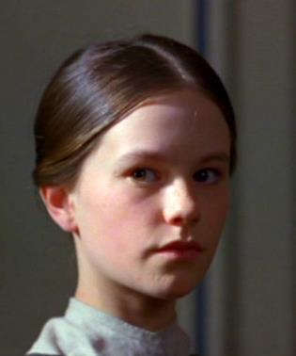
Here is how you might have described what Jane was like when she joined Lowood.
angry
determined
passionate
lonely
plain
Jane Eyre
young
rebellious
hardy
tough
Jane
What else did you come up with?
Where did Jane show these characteristics, and where did she learn them?

Slide 18
Here is how you might have described what kind of woman Jane is now.
kind
compassionate
creative
determined
loving
ambitious
resilient
Jane Eyre
moral
thoughtful
tough
plain
Jane
hardy
mild
proud
young
What else did you come up with?
Where did Jane show these characteristics, and where did she learn them?

Slide 19
On your own answer this question in paragraphs:
How has Jane changed across the novel so far?
Jane Eyre
Jane

Slide 20
The end…
This term, we have read about Jane Eyre’s childhood.
The Red Room, being called a liar and Helen Burns's death are some of the most famous parts of ‘Jane Eyre’.
But there is lots we haven’t read!
The rest of ‘Jane Eyre’ is one of the most exciting and popular novels of the Victorian era. Continue reading to find out about:
Mr Rochester: the handsome owner of Thornfield Hall with a terrible secret…
Bertha Mason: a mysterious and terrifying woman…
St. John Rivers: a devout Christian who wants to take Jane away with him…
The devastating fire at Thornfield Hall that reunites Jane with her true love…
Jane Eyre

Slide 21
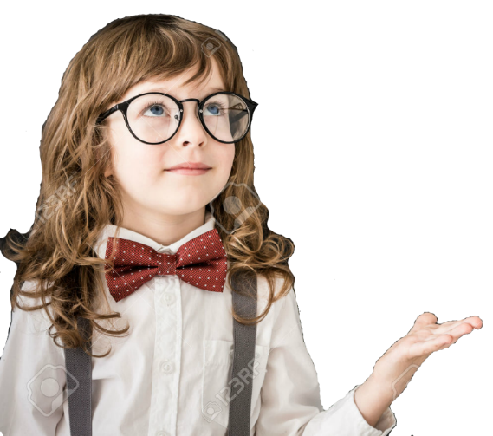
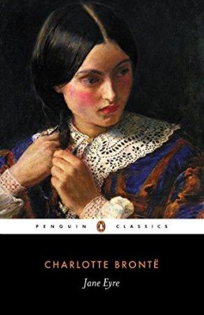
Final thoughts…
What were your favourite moments from ‘Jane Eyre’?
Who were your favourite characters? (They don’t have to be ‘good’ people!)
What is your opinion of Jane? Did your opinion of her change as you read more of the story?
What similarities are there between ‘Jane Eyre’ and ‘Oliver Twist’? ‘The Tempest’? ‘Animal Farm’?
Jane Eyre

Slide 22
Love this lesson?
Have suggestions for improvements?
Does something need fixing?
Feedback
Please let us know!
Fill in this feedback form so that we can keep improving.

