Slide 1
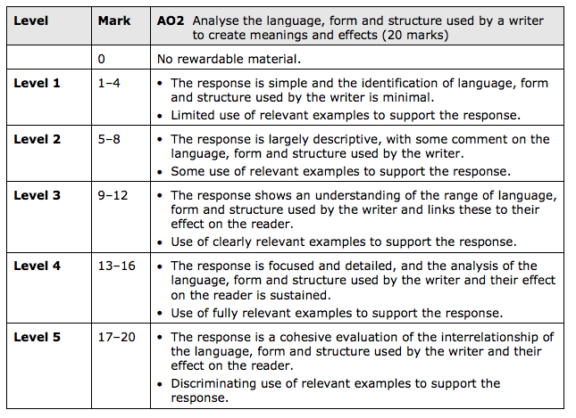
UNSEEN POETRY
Teacher Comment:
(To improve you need to)
NAME: DATE:
Student comment:

Slide 2
UNSEEN POETRY
UNSEEN POETRY
LIT PAPER 1, POETRY AND MODERN PROSE, SECTION A: UNSEEN POETRY
LIT PAPER 1, POETRY AND MODERN PROSE, SECTION A: UNSEEN POETRY

Slide 3
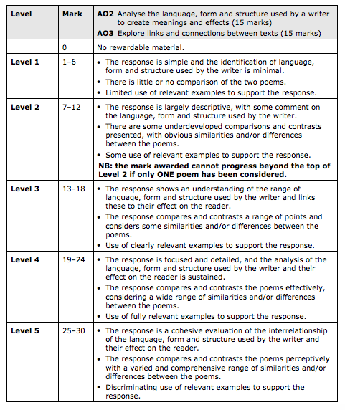
COMPARISON POETRY
Teacher Comment:
(To improve you need to)
NAME:
DATE:
Student comment:

Slide 4
COMPARISON POETRY
COMPARISON POETRY
COMPARISON POETRY

Slide 5
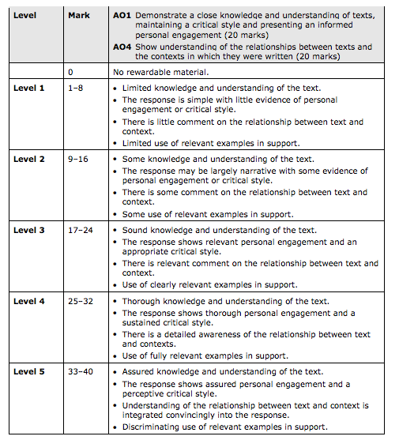
MODERN PROSE
Teacher Comment:
(To improve you need to)
NAME:
DATE:
Student comment:

Slide 6
MODERN PROSE
MODERN PROSE
MODERN PROSE

Slide 7
MODERN DRAMA
Teacher Comment:
(To improve you need to)
NAME:
DATE:
Student comment:

Slide 8
MODERN DRAMA
MODERN DRAMA
MODERN DRAMA

Slide 9
LITERARY HERITAGE
Teacher Comment:
(To improve you need to)
NAME:
DATE:
Student comment:

Slide 10
LITERARY HERITAGE
LITERARY HERITAGE
LITERARY HERITAGE

