Slide 1
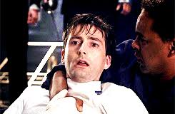
The end (denouement)
(finally!)
Tuesday 5th November
..brief recap on conventions of Tragedy?

Slide 2
Aristotle and tragedy?
ORIGINAL ARISTOTLE THEORY:
cannot be a hero that is undoubtedly good suddenly turn evil
nor can an evil villain suddenly encounter good fortune and turn good
these do not evoke emotion as they do not correlate with our human sympathy
Rather, the original theory of Aristotle's tragedy outlines the hero and his misfortune. It must be a mistake, error in judgement, or some other miscalculation that ultimately leads to his downfall. The audience must be able to relate to the hero; by sympathising with his mistake and realising that even they could have made a mistake that simple, fear and pity are evoked – an inherent FATAL FLAW/HAMARTIA

Slide 3
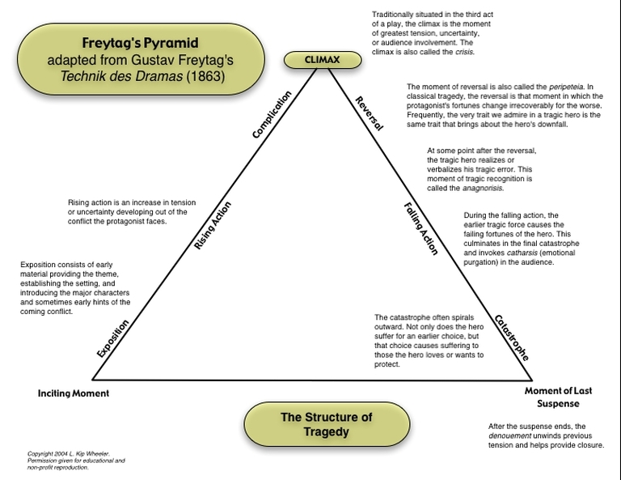
Freytag’s Pyramid?

Slide 5
HAMLET:
Exposition: Takes place in and around Elsinore Castle in Denmark. Main characters are Hamlet and Claudius Rising Action: Hamlet is contacted by his father's ghost, asking him to avenge his death Climax: Hamlet stabs through the curtain thinking Claudius is hidden, but kills Polonius instead. At this moment he is finally entangled in the revenge he so often swore to take. Hamlet realizes he must kill Claudius or his actions would be for nothing. Falling Action: The falling action of Hamlet's tragedy is his fencing match with Laertes. This scene ultimately leads to the downfall of literally every prominent character in the play, a tactic often employed by Shakespeare. Catastrophe: Fortinbras takes the Danish throne and declares himself King. Hamlet is tragically loyal to his father, and the revenge instilled in him ultimately leads to the downfall of Denmark.

Slide 6
Hamartia, peripeteia & anagnorisis Are we ok with definitions and able to give examples?
Hamartia = tragic/fatal flaw e.g. Hamlet did not intend for Ophelia to die
Peripeteia = reversal of circumstances/turning point e.g. when Claudius realises
Hamlet is ‘on to him’ during play within a play
Anagnorisis = moment of realisation/self discovery
e.g. Hamlet’s discovery via Ghost of Claudius’ actions
– galvanises action

Slide 7
RECAP: The importance of ACT 5 Scene 1 in particular (AO5) CRITIC (Nicholas Marsh)
This scene has two elements which are present in the rest of the play as a whole:
Society operates by compromising between public/moral laws and the brute facts of power, greed and lust. As a result, society is tainted and can only produce a mixture of good and evil, or the pretence of good covering evil. The play is full of moral compromises.
The complications of society (including people’s attitudes interpretations of each other’s motives, subterfuges etc) are shown to be futile and irrelevant to the eventual outcome.
QUESTION: Where do we see these ideas in this scene and elsewhere in the play?
Notes:
Moral compromises: Claudius trying to pray but failing; Gertrude doesn’t want to think about her infidelity until Ham forces it on her; Fortinbras is bought off by being offered safe passage to attack somebody else; Claudius sees Ham’s mourning is excessive; Laertes persuaded to revenge through poison and trickery
Futility: none of Claudius’ plots work; hiding and eavesdropping cause further disguise and then the death of Polonius; All the advice other characters give to each other/ all Hamlet’s thinking has ZERO effect!! R and G easily fooled and sent to their deaths; the final plot goes horribly wrong and everyone dies.

Slide 8
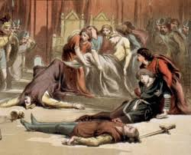
Read to end…

Slide 9
5.2 lines 1-66 – Hamlet’s change
To what extent is Hamlet presented as a changed man here?
Consider Hamlet’s use of the word ‘conscience’ here… how does it compare to earlier: ‘thus conscience doth make cowards of us all’.

Slide 10
5.2 lines 67-163– Purpose of Osric
What is the purpose of Osric? What does the mockery of his affectation suggest?
What characterises the imagery used to describe Osric?

Slide 11
5.2 164-202
Even though Hamlet suspects Claudius’s motives, he decides to fight anyway – why?
Is it stoicial fatalism or Christian providence or serenity in the face of death?
Does this mean Hamlet is now embracing his role as revenge hero or is merely resigned to it?
Is he taking control or has he simply relinquished it?

Slide 12
5.1 203-345 Everyone dies!
How can this section be seen as a dramatic re-enactment or physical manifestation of the corruption that has been such a concern throughout the play?
How might different directors/actors interpret this final scene? What are some of the possibilities?
How do you respond to Hamlet’s death?
What might his enigmatic final line, ‘The rest is silence’, reveal? How should it be spoken? With a tone of romantic heroism or dejected failure, triumphant achievement or tragic waste?

Slide 13
5.1 346-end – a new era?
The political and military intrude on the personal and religious drama we have just witnessed; what is the effect of this?
Although the multiple deaths have superficially resolved key issues of the play (Hamlet achieves his revenge, conflict ceases, Claudius’ falseness is revealed and a new ruler emerges), do we feel satisfied?

Slide 14
“The end is a half-line after a rhyming couplet – as if there were more to come – as there must be after every tragedy”- MacDonald
Are you satisfied by the ending?
Is there a moral lesson? Or is this just senseless tragedy?
- Is Hamlet’s indecision the cause of the tragedy?

Slide 15
REVISION: Over to you!
Hamlet Homework for next week (Unseen USA week after)
1 Extract Analysis of your choice
1 Thematic (from list already seen on Firefly – HCB has reposted it)
Make sure mark schemes are FULLY ADHERED to. Your BEST efforts.

