Slide 1
Romeo & Juliet
William Shakespeare

Slide 2
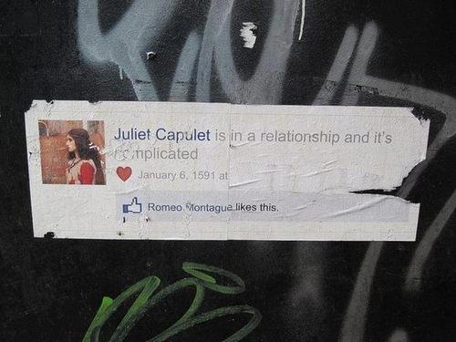

Slide 3
Setting: Verona, Italy

Slide 4
Feuding Families
CAPULET
MONTAGUE
V

Slide 5
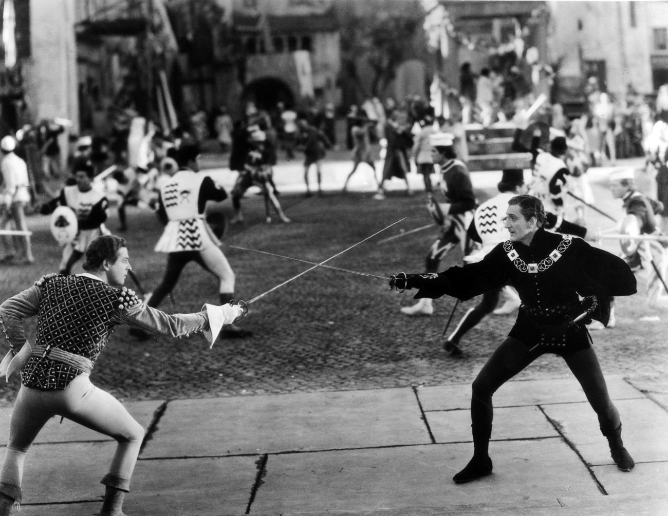

Slide 6
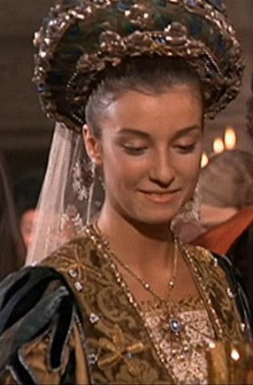

Slide 7
Will love blossom?
Lord Capulet dispatches a servant with a list of people to invite to a masquerade and feast he traditionally holds. He invites Paris to the feast, hoping that Paris will begin to win Juliet’s heart.

Slide 8
The gate crashers…
Benvolio suggests that Romeo goes to the Capulet ball to take his mind off Rosaline. Romeo agrees to go because he knows that Rosaline will be there. They are joined by the witty Mercutio.

Slide 9
Love at first sight…
Romeo and Juliet are attracted to each other and kiss. When they learn of each others true identity they are equally distraught.
Did my heart love till now? Forswear it, sight!
For I ne'er saw true beauty till this night.

Slide 10
Balcony Scene
O Romeo, Romeo, wherefore art thou Romeo? Deny thy father and refuse thy name, Or if thou wilt not, be but sworn my love, And I’ll no longer be a Capulet.
As Mercutio and Benvolio leave the Capulet estate, Romeo jumps over the orchard wall into the garden, unable to leave Juliet behind. From his hiding place, he sees Juliet in a window above the orchard and hears her speak his name. He calls out to her, and they exchange vows of love.
“What’s in a name?” Juliet asks.
“That which we call a rose
By any other word would smell as sweet”

Slide 11
The Plan
Romeo hurries to see his friend and confessor Friar Lawrence.
Although shocked at the sudden turn of Romeo’s heart, he agrees to marry the young lovers in secret.
He believes that their love has the possibility of ending the age-old feud between the Capulet and Montague families.
The following day, Romeo and Juliet meet at Friar Lawrence’s cell and are married.

Slide 13
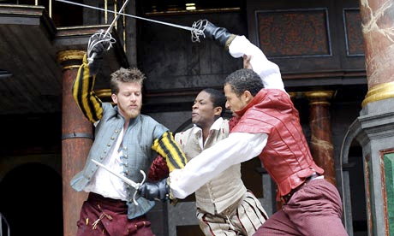
The next day……
Benvolio and Mercutio encounter Tybalt (Juliet’s cousin) who, still enraged that Romeo attended Capulet’s feast, has challenged Romeo to a duel.
Romeo appears. Now Tybalt’s kinsman by marriage, Romeo begs the Capulet to hold off the duel until he understands why Romeo does not want to fight.
Disgusted with this plea for peace, Mercutio says that he will fight Tybalt himself. Although Romeo tries to separate them, Tybalt stabs Mercutio under Romeo’s arm and Mercutio dies.
Romeo, in a rage, kills Tybalt. Romeo flees from the scene. Soon after, the Prince declares him forever banished from Verona for his crime.

Slide 14
Juliet suddenly finds herself married to a man who has killed her cousin, a man who has been banished from Verona
Was ever book containing such vile matter So fairly bound?
O serpent heart, hid with a flowering face!

Slide 15
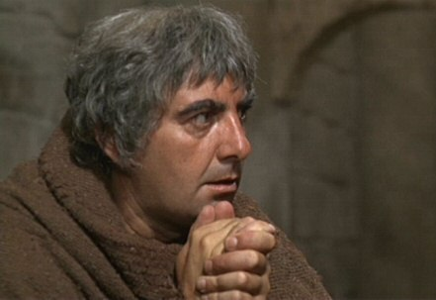
The Plan
Juliet learns that her father, affected by the recent events, now intends for her to marry Paris in just three days.
Unable to reveal to her parents that she is married to Romeo, but unwilling to marry Paris now that she is Romeo’s wife —Juliet asks her nurse for advice.
Juliet disregards her nurse’s advice (to ditch Romeo) and hurries to Friar Lawrence. He concocts a plan to reunite Juliet with Romeo.
The night before her wedding to Paris, Juliet must drink a potion that will make her appear to be dead. After she is laid to rest in the family’s tomb, the Friar and Romeo will secretly retrieve her, and she will be free to live with Romeo, away from their parents’ feuding.

Slide 16
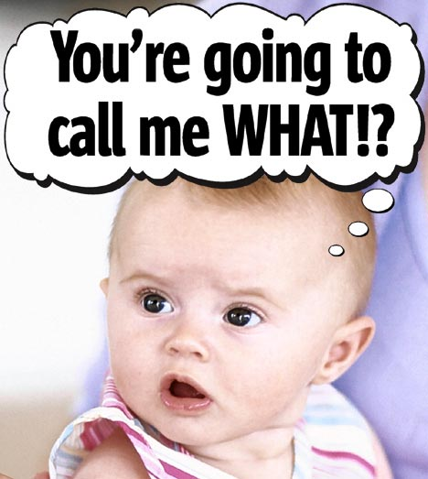
What could possibly go wrong?
What could possibly go wrong?

Slide 17
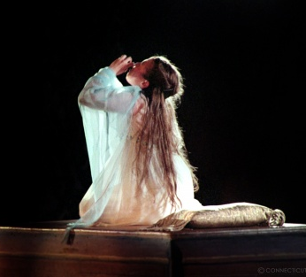
The plot thickens…..
Juliet returns home to learn that her wedding has been moved forward one day
She drinks the potion and the nurse finds her, apparently dead, the next morning
Everything is going to plan
But Friar Lawrence’s message explaining the plan to Romeo never reaches him
He hears Juliet has died and decides to kill himself rather than live without her
He goes back to Verona to take his own life at Juliets tomb

Slide 18
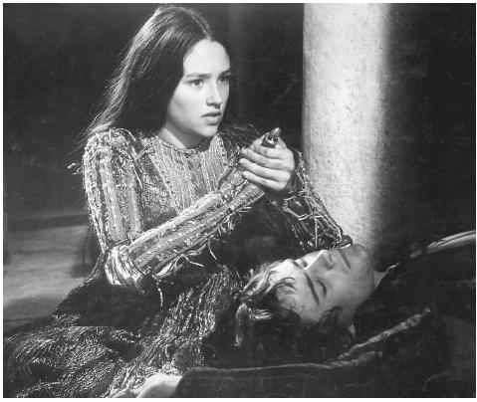
True love….
Romeo buys a vial of poison and speeds back to Verona
When he reaches the Capulet tomb he sees Paris scattering flowers
They fight, Romeo kills Paris before entering the tomb
Romeo sees Juliet’s lifeless body, drinks the poison and dies by her side
Juliet awakes and refuses to leave with Friar Lawrence who had arrived too late to save Romeo
Juliet kisses her husbands lips, and when that does not kill her she stabs herself in the chest with his dagger, falling dead on his body

Slide 19
Peace in Verona
We learn that Lady Montague has died of grief over Romeo’s exile.
Seeing their children’s bodies, Capulet and Montague agree to end their long-standing feud and to raise gold statues of their children side-by-side in a newly peaceful Verona.

