Slide 1
Theme: self-discovery and reflection
Autobiography, personal narrative

Slide 2
Learning Objectives
Practice my unseen text skills using one of the anthology texts
Learn how to understand the main idea of a text, using active reading strategies

Slide 3
Starter
Interview your partner and discuss the following things:
How do you feel about school?
What are your learning strengths and weaknesses?
How do you feel about reading?
What do you read?
How do you feel about writing?
Which piece of school work do you feel most proud of?
Pairs/3:
F & M
Sa, P & A
Mo, D & Sh

Slide 4
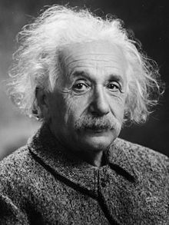
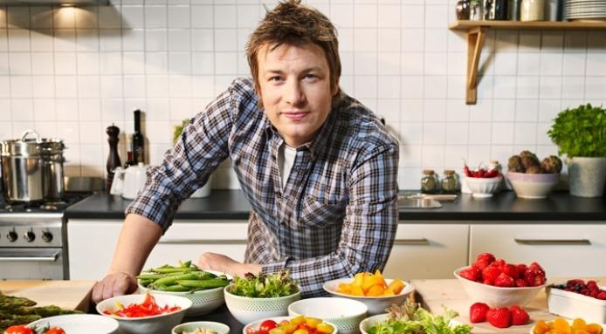
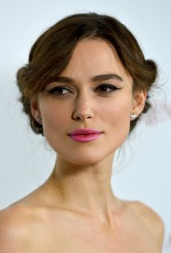
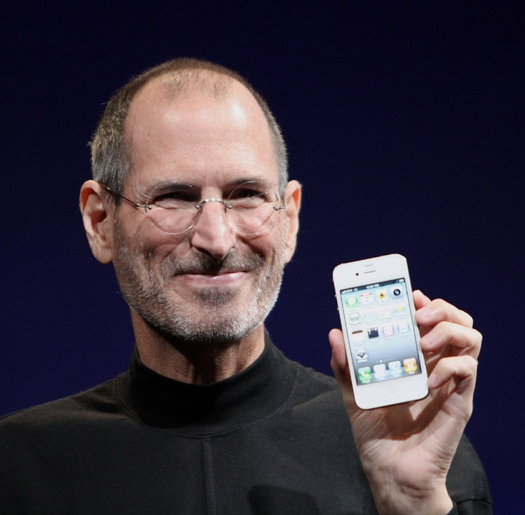
Photos – what do these people have in common?

Slide 5
Video – Talking Turkeys
https://www.youtube.com/watch?v=v4AgPSjzXkw

Slide 6
Young and dyslexic? You’ve got it going on
Author: Benjamin Zephaniah (anthology page 12)
Q1 (1 mark):
How old was Zephaniah when he stopped going to school?
Q2 (3 marks):
Look again at lines 9 – 35. What are three words or phrases which show Zephaniah’s teachers thought badly of him?
Reading skill: scanning

Slide 7
Young and dyslexic? You’ve got it going on
Q3 (4 marks):
In your own words, explain what we learn about Zephaniah’s character.
Reading skill: inferring (reading between the lines)

Slide 8
UNDERSTANDING THE MAIN IDEA
You can learn how to do it! Let’s highlight some things:
Use the first sentence of each paragraph to give you a clue about the main idea.
Any words in the text you don’t understand.
What you think is the key idea from each paragraph.

Slide 9
UNDERSTANDING THE MAIN IDEA - CONTINUED
Now let’s add these things together.
Look up the words you don’t understand, or try to figure them out from the context of the sentence. These can give you important clues as to the writer’s intentions.
See if there are any common themes amongst your topic sentences.
See if your main ideas from each paragraph lead towards an idea or conclusion.
This is the main idea of the text ☺

Slide 10
YOUNG AND DYSLEXIC – MAIN IDEA?
I think the main idea of Y&D is:
If you’re living with dyslexia you’re not alone, and you should embrace it and use it to your advantage by being creative (Frank).
There’s nothing wrong with having dyslexia; in a way it’s a superpower that makes you special (Shane).
Telling people who have dyslexia to be proud of themselves, instead of feeling under-confident, by sharing Zephaniah’s experiences (Athley).

Slide 11
YOUNG AND DYSLEXIC – MAIN IDEA?
If you have dyslexia, it doesn’t mean there is something wrong with you. In fact, having dyslexia can make you creative.

Slide 12
TEXT TYPE: AUTOBIOGRAPHY
Check your notes – what do we know about autobiographies?

Slide 13
LANGUAGE & STRUCTURAL DEVICES
Fill in your techniques table using the definitions below. Then, find examples from the text.
Dialogue / direct speech: when one character is speaking to another.
Why it’s used: to add ‘voice’, different perspectives, or to convey feelings/thoughts quickly.
2) Rule of 3: when a list of three similar words/phrases are grouped together.
Why it’s used: to emphasise the concept, often for emotional effect, or to help the reader remember it.

Slide 14
LANGUAGE & STRUCTURAL DEVICES
3) Emotive language: words and phrases which are strong in terms of the emotions we might feel when reading them
Why it’s used: to convince the reader of an idea, to make a story more vivid, to emphasise a main idea/point/theme, to make writing more personal.
4) Anecdotes: when a writer shares brief personal stories
Why it’s used: to personalise a text, to help engage the reader, to explain a point or give an example, to add humour.

Slide 15
LANGUAGE & STRUCTURAL DEVICES
5) Direct address: when the writer addresses the reader by saying “you”, “your” or “yourself”.
Why it’s used: to engage the reader and make it feel like they are having a conversation with the writer, or that they are involved in the story. Can also be used to encourage people to take action.
6) Rhetorical question: when a writer poses a question that doesn’t necessarily have/require an answer.
Why it’s used: to engage the reader and make them think about the topic.

Slide 16
LANGUAGE & STRUCTURAL DEVICES
7) Inclusive pronouns: when the writer uses “we”, “us” or “our”.
Why it’s used: to make the reader feel like they are in the same group as the writer. This can help us want to take action, or can help us connect with the writer.

Slide 17
LANGUAGE AND STRUCTURAL DEVICES: Carousel
Each table has a different quote.
Station 1: Circle the correct language technique name for your quote.
Station 2: What are some important words in your quote? What are the connotations of these words?
Station 3: What can you add to the previous team’s work?
Station 4: Why do you think Zephaniah used this technique/quote?
Station 5: Anything else.

Slide 18
NOTES IN YOUR ANTHOLOLGY - TAP
Type (genre):
Audience:
Purpose:
Main themes/ideas in the text?

Slide 19
20-03-18 Young and dyslexic
Starter:
Look over your homework feedback.
2) What target can you set yourself based on the feedback?
3) Post it to the Showbie folder 20th March target setting.

Slide 20
WRITING TASK: Analysis
How does the writer use language and structure to show his readers the challenges and triumphs of having dyslexia?
Let’s make a plan together.

Slide 21
Challenges
Triumphs
*
*

Slide 22
23-03-18 Young and dyslexic
Starter:
Look over your essay feedback.
Did you get a higher or lower mark than you expected?
Go back to your target you set on Showbie (folder → 20th March target setting). Did you meet this target?
In the same folder, post something you are happy with and something you want to keep working on (relating to this essay).

Slide 23
ESSAY FEEDBACK
WWW:
Purposeful choice of quotes (your quotes/techniques linked really well to the points you were making).
Nobody went off on random tangents – everybody kept on the right track ☺
Good understanding of different language techniques.
EBI:
- Need to continue analysing language: let’s do another example together.

Slide 24
LANGUAGE ANALYSIS EXAMPLE
Our connection was electrifying: shocking, jolting, jarring, exciting.
On your page, consider:
What language devices are present?
What is the literal meaning of these words?
What is the connotation / figurative meaning?
What is the overall feeling in the quote, and why?

Slide 25
27-03-18 Starter
Quick language analysis (like last lesson) …
“The man pulls an enormous, enormous hawk out of the box and a great flood of sunlight drenches us and everything is brilliance and fury.”
Techniques?
Feeling / atmosphere?
What does the quote mean?

Slide 26
WRITING TASK: Speech
Based on ‘Young and dyslexic’.
Write a speech sharing a personal experience which changed your perspective on an important issue.
Or … WRITING TASK: Autobiography
Based on ‘Young and dyslexic’.
Write about a time where you have had to overcome a challenge.

Slide 27
MARKING CRITERIA
Let’s have a look at the mark scheme for this type of task (on Showbie).
What do you notice about what you need to do?
Choose 1-2 targets for this task. Post them to Showbie (Target setting folder).

Slide 28
BRAINSTORMING – WRITING TASK
Note down as many ideas as possible for your writing task, in 3 minutes.
Don’t forget to include some crazy or wild ideas.
Don’t worry about how good they are yet – your aim is to get as many ideas as possible!

Slide 29
STARTER – CLASS DISCUSSION – 28-03-18
What do you think might be some differences between an autobiography and a speech?
You can use your research notes to help you.

Slide 30
EXAMPLES

Slide 31
29 – 03 – 18 STARTER: TALKABOUT WALKABOUT
Spend 5 minutes roaming around the room. Ask the people you meet what their writing task topic will be.
Try to pay attention and remember, as I will ask you to tell me about other people’s ideas when we finish!

Slide 32
OPENING LINES - WORKSHEET
Let’s look at the opening lines worksheet on Showbie (Y&D writing task folder).

Slide 33
PLENARY – IT’S THE LITTLE THINGS
Little touches make your piece of writing truly exceptional.
This can come down to the opening line you use, or the way you punctuate your piece.
To finish up, correct the punctuation on the worksheet from Ms Robinson ☺
And have a great Easter weekend!

Slide 34
Y & D wrap up: 06 – 04 - 18
Benjamin Zephaniah talking about dyslexia:
https://www.youtube.com/watch?v=ZJTwVJLJzyI
Team trivia time! Get into teams of 3. You will need:
Paper
Pen / pencil
A copy of the anthology text

