Slide 1
Act 4, scenes 1-4

Slide 2
Quick test...
What is ‘hamartia’?
What is ‘catharsis’?
Could a maid be a tragic protagonist? Explain your answer.
What should happen to the protagonist before he/she dies?
At the end of tragedies, what should be the purpose of all this suffering?

Slide 3
Concept of tragedy
Tragedy originates from character; all tragic heroes have a single recognisable character flaw which is their undoing. This is far more important than any external factors.
Protagonist must be high born and noble in rank or character to emphasise the fall from grace. The fall is attributed to ‘hamartia’, a terrible decision or a character flaw, and will have catastrophic effects.
Tragedy comes from the conflict within; namely, the battle between rationality and order and wilder, emotional desires. Tragedies do not end in divine justice/ happy ending but in meaningless slaughter. They reveal there is no divine justice.
Tragedy originates not from the battle between right and wrong, but the battle between opposing ideologies or belief systems – just like History does.
Whose theory?
Links to Hamlet?

Slide 4
Quick test...
What is ‘hamartia’? A character flaw/ fatal decision
What is ‘catharsis’? A purging of emotion
Could a maid be a tragic protagonist? Explain your answer! Not typically, no – must be a character of high status.
What should happen to the protagonist before he/she dies? A moment of revelation/epiphany (anagnorisis)
At the end of tragedies, what should be the purpose of all this suffering? (a sense that we have learnt something; hope for the future; a cleansing has taken place)

Slide 5
Concept of tragedy | Associated with
Tragedy originates from character; all tragic heroes have a single recognisable character flaw which is their undoing. This is far more important than any external factors. | AC Bradley – Hamlet’s flaw – uncertainty? Inability to act? The fact he is a thinker? Childishness?
Protagonist must be high born and noble in rank or character to emphasise the fall from grace. The fall is attributed to ‘hamartia’, a terrible decision or a character flaw, and will have catastrophic effects. | Aristotle – Hamlet is a ‘prince out of thy star’ – his decision not to act OR to kill Polonius?
Tragedy comes from the conflict within; namely, the battle between rationality and order and wilder, emotional desires. Tragedies do not end in divine justice/ happy ending but in meaningless slaughter. They reveal there is no divine justice. | Nietzsche – Hamlet’s inner conflict – his desire to revenge/hurt (evidenced in treatment of Ophelia, Gertrude, Polonius, mood swings, shifting language) There is no happy ending; all must die. Shakespeare does not allow a moral happy ending
Tragedy originates not from the battle between right and wrong, but the battle between opposing ideologies or belief systems – just like History does. | Hegel – two ideologies – young v old – Claudius v Hamlet – Old Hamlet v Hamlet -

Slide 6
Act 4…
Sets play back into its political context – the outside is coming in
Audience reminded that England, recently defeated in a bloody battle, is Denmark’s client state
Expands play’s political horizons; we move outside of Elsinore and see the army of Norway, marching to invade Poland
Hamlet sent to England with R and G – to his ‘death’
Fortinbras re-introduced
Turning point for Hamlet? Cumberbatch said in an interview that he goes away and grows up.

Slide 7
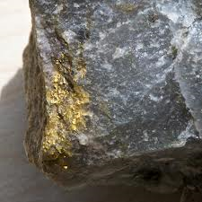
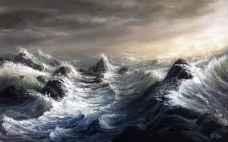
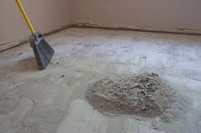
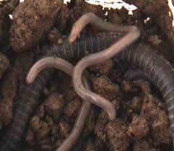
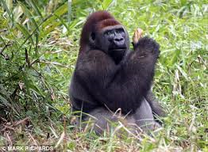
How are the following images used in the opening to act 4 scene, 1 and 2? Find the line and note what they reveal about the corresponding characters
Rosencrantz and Guildenstern
Hamlet
Claudius
Polonius

Slide 8
4.3
How does Shakespeare emphasise Hamlet’s disruption/anarchy in this scene?
What does Hamlet’s increasing focus on mortality and death in this scene suggest he has fully realised by this point?
Claudius says of Hamlet: ‘like the hectic in my blood he rages’. This is another reference to illness; how is this different to what we have seen before?

Slide 9
4.4
Fortinbras sends an army to ask Claudius’ permission to pass through Denmark whilst on the way to invade Poland
The Captain tells Hamlet they will fight (with great loss of life) for a tiny, unprofitable part of Poland
Hamlet reflects upon an apparently healthy society where thousands will die in battle over a ‘straw’
This thought prompts his final soliloquy where he reproaches himself again for failing to avenge his father’s death

Slide 10
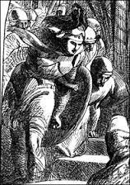
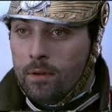
Act 4 scene 4 is the first time the audience see Fortinbras. What do the audience already know about him? Try to think of at least 1 direct quotation we have heard about him AND 1 adjective that might apply to him

Slide 11
“Rightly to be great/ Is not to stir without great argument/ But greatly to find quarrel in a straw/ When honour’s at stake.”
“…death and danger dare/ Even for an eggshell.”
“divine ambition puffed”
“a fantasy and trick of fame”
“O from this time forth,/ My thought be bloody or be nothing worth.”
QUESTIONS:
Find these quotes in Hamlet’s soliloquy – understand what each is about.
What do these quotations suggest Hamlet has realised about human nature? Why does it prompt him into (what seems like) action?

Slide 12
Quote | Who said it? About what/who?
A mote it is to trouble the mind’s eye…
Why seems it so particular with thee?
That spirit upon whose weal depends and rests/ The lives of many
So as a painted tyrant Pyrrhus stood/ like a neutral to his will and matter/Did nothing
Like sweet bells jangled out of time and harsh – That unmatched form and stature of blown youth
not a pipe for fortune’s finger
Let not the bloat king tempt you to bed again
Is there not rain enough in the sweet heavens/ To wash it white as snow?
So excellent a king, that was to this/ Hyperion to a Satyr

Slide 13
Quote | Who said it? About what/who?
A mote it is to trouble the mind’s eye… | Horatio, 1.1 – about the ghost; suggests it foreshadows future catastrophe
Why seems it so particular with thee? | Gertrude to Hamlet, 1.1 – about his grief about father; prompts Hamlet’s speech about ‘seems’
That spirit upon whose weal depends and rests/ The lives of many | Rosencrantz 3.3 – connection of society/ chain of being
So as a painted tyrant Pyrrhus stood/ like a neutral to his will and matter/Did nothing | Player 2.2 – speech about Pyrrhus about to kill Priam – there is a pause although he does go on to kill him
Like sweet bells jangled out of time and harsh – That unmatched form and stature of blown youth | Ophelia 3.1 – Ophelia’s description of Hamlet’s madness
not a pipe for fortune’s finger | Hamlet 3.2 – on Horatio
Let not the bloat king tempt you to bed again | Hamlet, 3.4 - Claudius
Is there not rain enough in the sweet heavens/ To wash it white as snow? | Claudius 3.3 – on his ‘offence’
So excellent a king, that was to this/ Hyperion to a Satyr | Hamlet 1.2 – comparing father and Claudius

